Slide 1
2016 NCAE
Test Administration Guidelines

Slide 2
ACRONYMS
SDS -Schools Division Superintendent
DTC -Division Testing Coordinator
PSS -Private School Supervisor
SH -School Head
STC -School Testing Coordinator
CE -Chief Examiner
RS -Room Supervisor
RE -Room Examiner
LRN -Learner Reference Number
TMs -Test Materials
TB -Test Booklet
SAS -Scannable Answer Sheet
EH -Examiner’s Handbook
SSH -Scannable School Header
ETRE -Examiner’s Transmittal Report Envelope
CETRE -Chief Examiner’s Transmittal Report Envelope
COR -Certificate of Rating

Slide 3
Responsibilities of the Testing Staff
The Chief Examiner’s (CE) Workflow

Slide 4
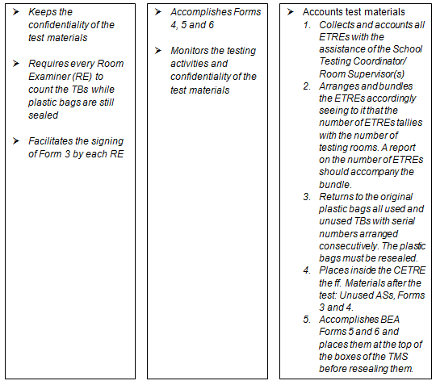

Slide 5
The Room Examiner’s (RE) Workflow

Slide 6
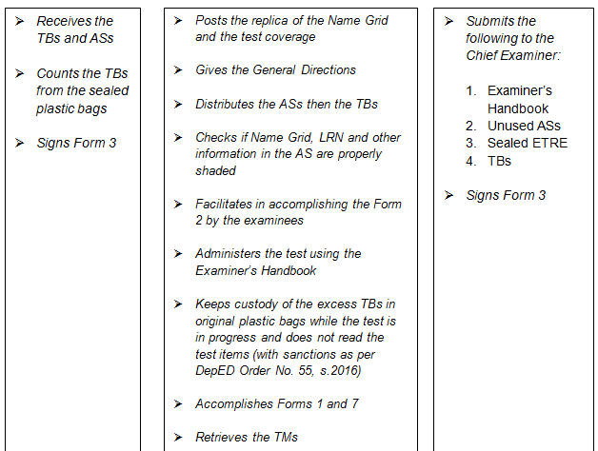

Slide 7


Slide 8
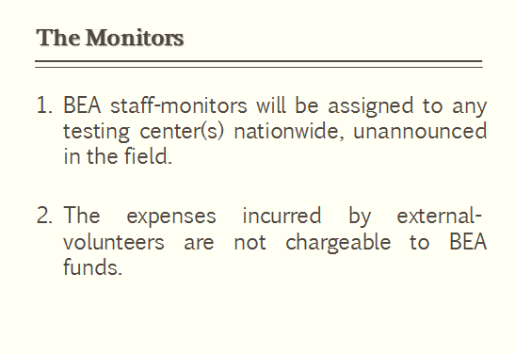

Slide 9

The Enrolment Data, School ID and Learner Reference Number

Slide 10
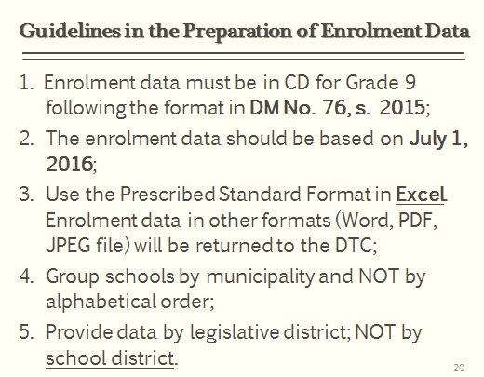

Slide 11
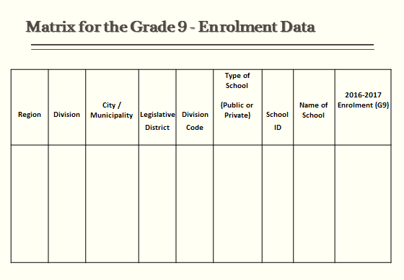

Slide 12
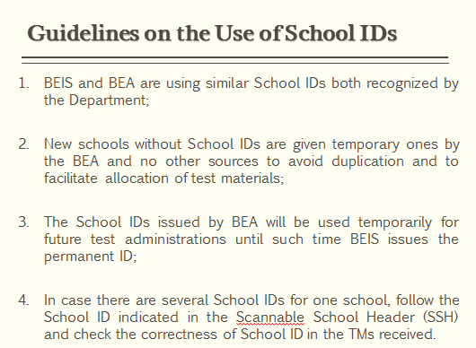

Slide 13
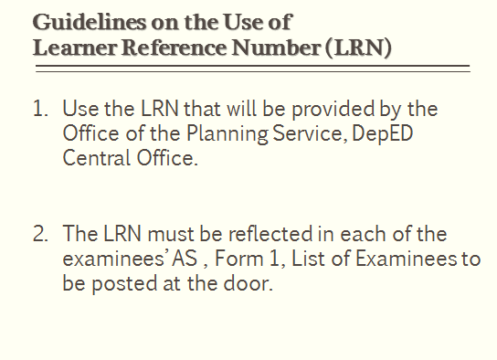

Slide 14
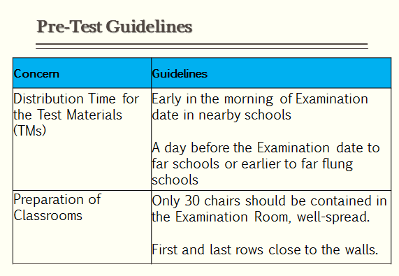

Slide 15
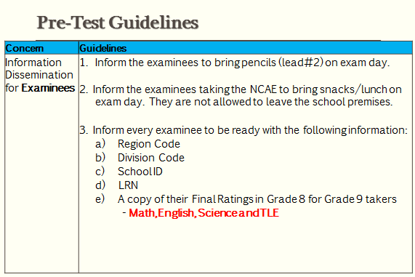

Slide 16
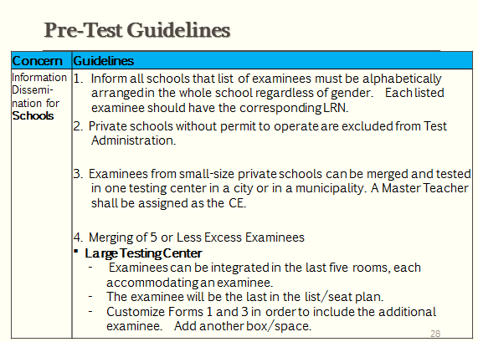

Slide 17
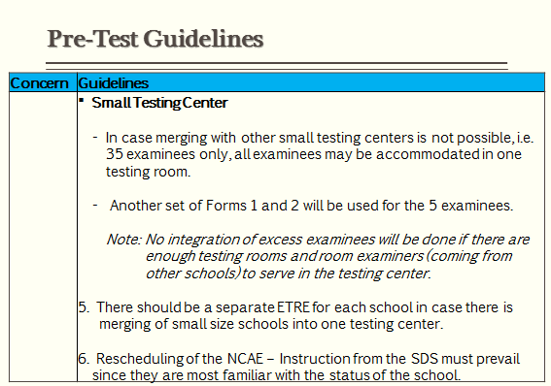

Slide 18
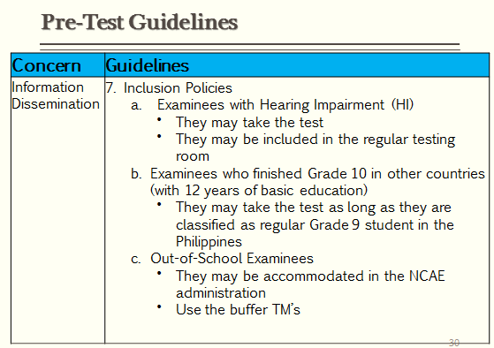

Slide 19
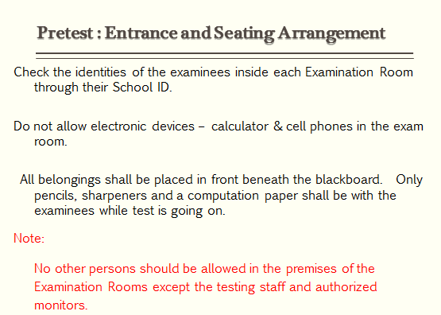

Slide 20
Allocation of Test Materials
I. Test Booklets. There shall be two (2) booklets for NCAE: Test Booklets A and B.
Booklet A contains the General Directions, Examinee’s Descriptive Questionnaire (EDQ), General Scholastic Aptitude (GSA), Technical-Vocational-Livelihood and Sports subtests.
Booklet B contains the Academic Tracks (HUMMS, STEM and ABM), Arts and Design and Occupational Interest Inventory subtests.

Slide 21
II. Answer Sheets. The examinees shall use scannable Answer Sheets designed specifically for NCAE.
IMPORTANT: Every examinee must receive two sheets of AS with the same serial number- one for Day 1 and the other for Day 2. The RE must check that the serial numbers of the two sheets are identical.

Slide 22
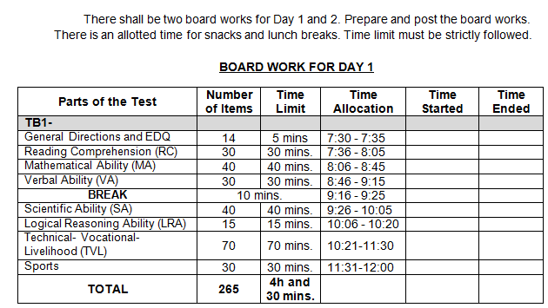
Board Work

Slide 23
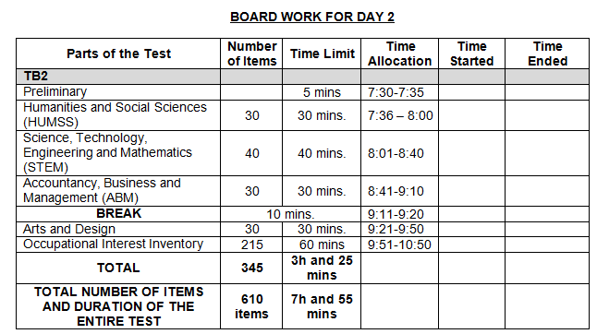
Board Work

Slide 24
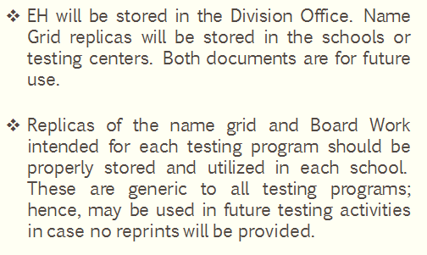
On the Storage of Examiner’s Handbook and Replicas of Name Grid

Slide 25
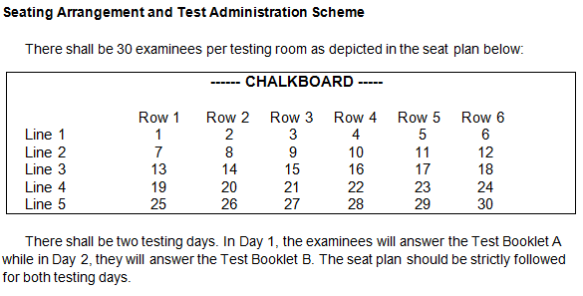

Slide 26
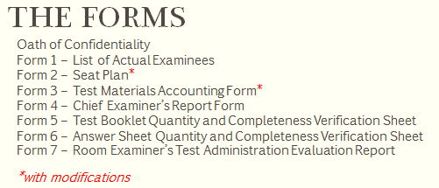

Slide 27
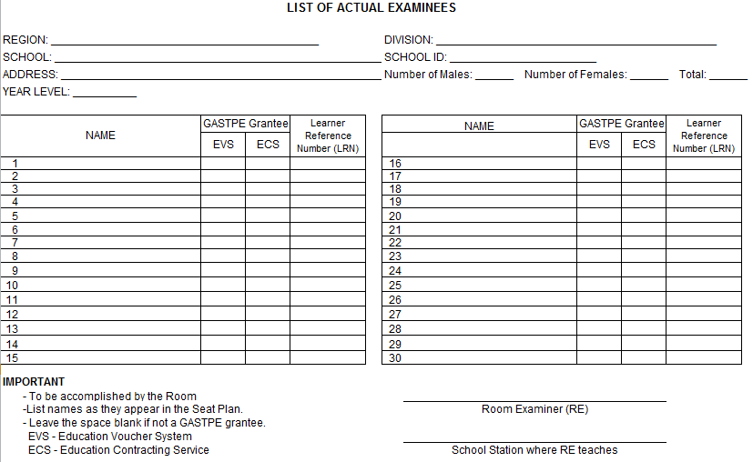
FORM 1

Slide 28
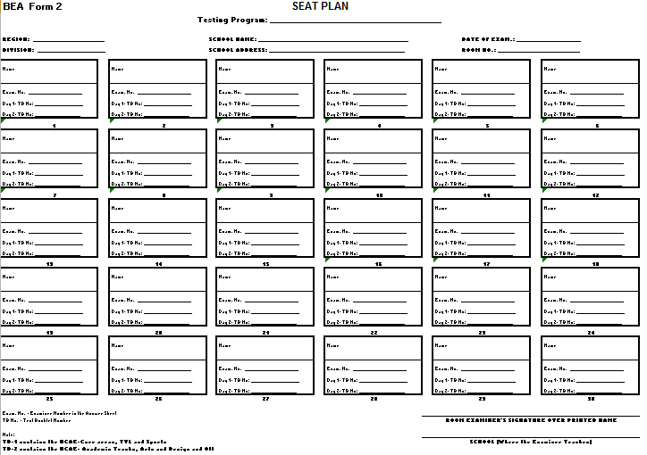
FORM 2

Slide 29
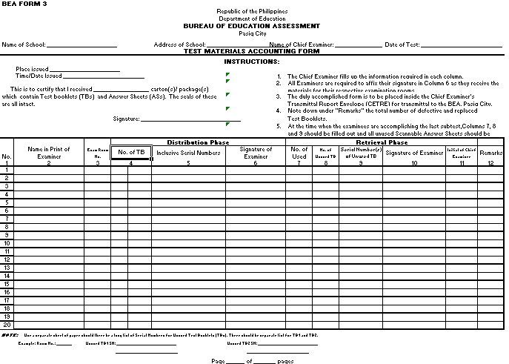
FORM 3

Slide 30
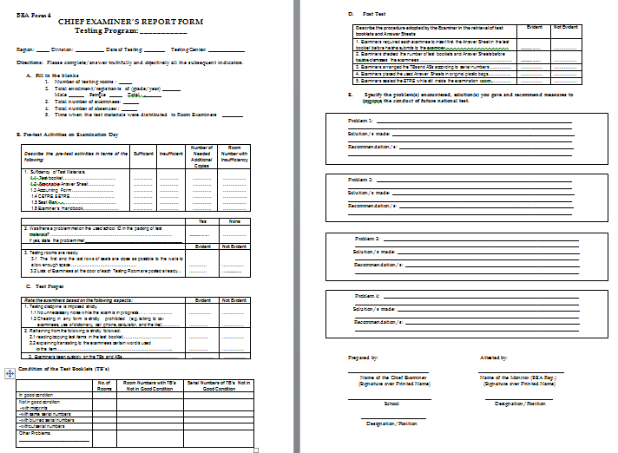
FORM 4

Slide 31
Forms 5 and 6

Slide 32
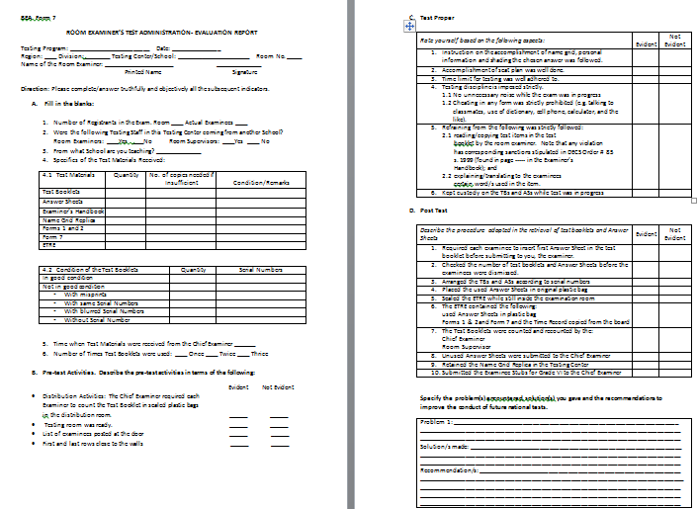
Form 7

Slide 33
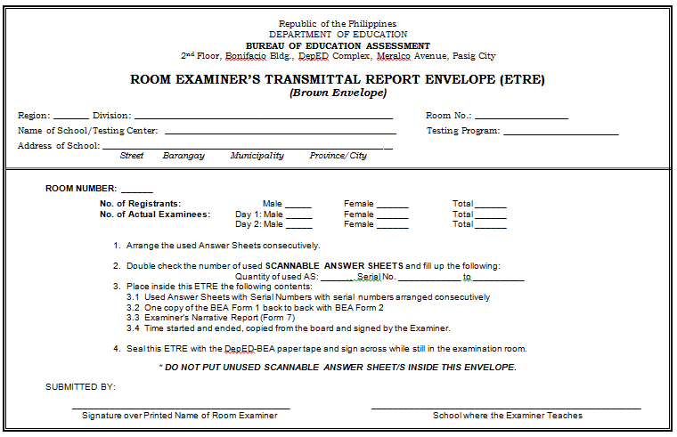
ETRE

Slide 34
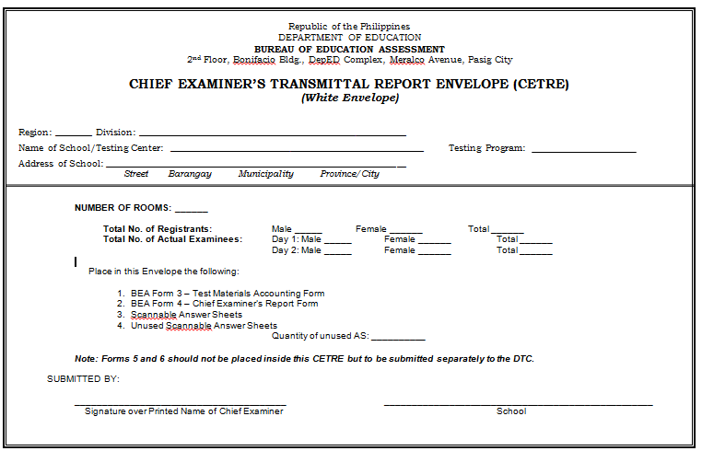
CETRE

Slide 35
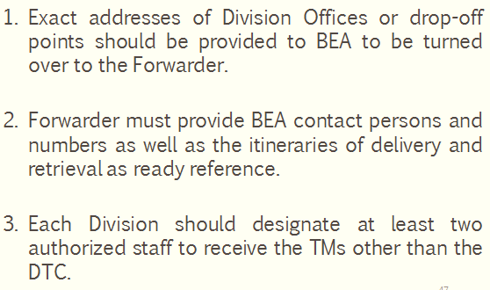
The Forwarder of the Test Materials

Slide 36
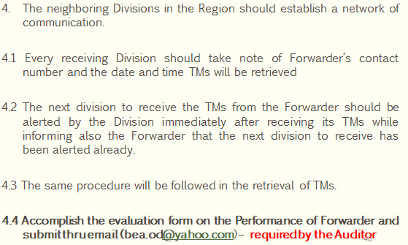
The Forwarder of the Test Materials

Slide 37
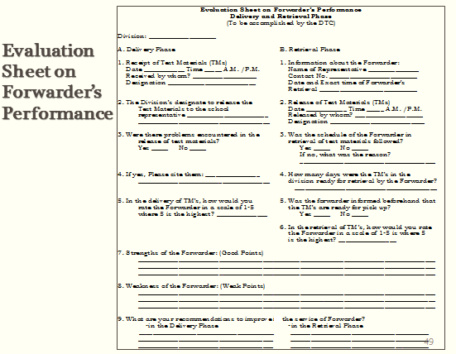

Slide 38
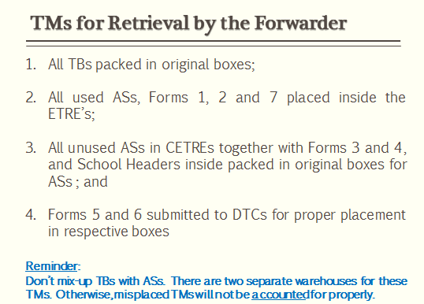

Slide 39
