Slide 1
Orientation on Withholding Taxes
Good Afternoon!!!
Presented by:
MARULYN A. CANTIVEROS, CPA

Slide 2
Who are designated as Withholding Agents
For Barangays : Brgy. Captain
Brgy. Treasurer
For Municipality : Mayor
and Cities Treasurer/Accountant
Provincial : Provincial Governor
Treasurer/Accountant
Govt. Owned and
Controlled Corporation : Accountant/Head of Office
Departments
Bureaus
Agencies
Other Government Offices

Slide 3
Hereinbelow are the answers to the foregoing questions:
a) Purchase of Goods
Selling Price P1,000.00
Output VAT (P1,000.00 x 12%) 120.00
Invoice Amount P1,120.00
Less:
5% withholding of final VAT (P1,000.00 x 5%) (50.00)
1% withholding of Income Tax (P1,000.00 x 1%) (10.00)
Amount Payable to supplier of Goods P1,060.00

Slide 4
b) Purchase of Service
Selling Price P5,000.00
Output VAT (P5,000.00 x 12%) 600.00 Invoice Amount P5,600.00 Less:
5% withholding of final VAT (P5,000.00 x 5%) (250.00 )
2% withholding of Income Tax (P5,000.00 x 2%) (100.00)
Amount Payable to supplier of Services P5,250.00

Slide 5
Example: GOVERNMENT PURCHASES FROM VAT REGISTERED SUPPLIERS OF GOODS AND/OR SERVICES
A government agency has the following purchases for the month of January, 2016 from VAT registered suppliers of goods and/or services:
Invoice Amount Purchase of Goods P1,120.00
(inclusive of VAT)
Purchase of Services (inclusive of VAT) 5,600.00

Slide 6
How will the government agency compute for the amount due to their suppliers?
How will the government agency compute for the amount of withholding tax to be filed and remitted for the month of January, 2016?

Slide 7
Hereinbelow are the answers to the foregoing questions:
a) Purchase of Goods
Selling Price P1,000.00
Output VAT (P1,000.00 x 12%) 120.00 Invoice Amount P1,120.00 Less:
5% withholding of final VAT (P1,000.00 x 5%) (50.00)
1% withholding of Income Tax (P1,000.00 x 1%) (10.00)
Amount Payable to supplier of Goods P1,060.00

Slide 8
Purchase of Service
Selling Price P5,000.00
Output VAT (P5,000.00 x 12%) 600.00
Invoice Amount P5,600.00
Less:
5% withholding of final VAT (P5,000.00 x 5%) (250.00) 2% withholding of Income Tax (P5,000.00 x 2%) (100.00)
Amount Payable to supplier of Services P5,250.00

Slide 9
Example: GOVERNMENT PURCHASES FROM NON-VAT REGISTERED SUPPLIERS OF GOODS AND/OR SERVICES
A government agency has the following purchases for the month of January, 2007 from NON-VAT registered taxpayer: Invoice Amount Purchase of Goods P1,000.00 Purchase of Services 5,000.00 How will the government agency compute the amount of withholding tax due from their suppliers? How will the government agency compute for the amount of withholding tax to be remitted for the month of January, 2007?

Slide 10
Hereinbelow are the answers to the foregoing questions:
a) Purchase of Goods
Selling Price P1,000.00
Less:
3% withholding of Percentage Tax 5 (P1,000.00 x 3%) (30.00)
1% withholding of Income Tax (P1,000.00 x 1%) (10.00)
Amount Payable to the supplier of Goods P 960.00

Slide 11
Purchase of Service
Selling Price P5,000.00
Less:
3% withholding ofPercentage Tax (P5,000.00 x 3%) (150.00)
2% withholding of Income Tax (P5,000.00 x 2%) (100.00)
Amount Payable to supplier of Services P 4,750.00

Slide 12
To issue Certificates
BIR Form 2307 - Creditable, GVAT and GMP
BIR Form 2306 - Certificate of Final Tax withheld at source

Slide 13
The person in-charge of withholding in each government agency (Government offices, bureaus, agencies or instrumentalities, local government units, GOCCs) shall prepare the following forms, file the tax returns to the appropriate BIR collecting agents and pay the corresponding withholding taxes due thereon, to wit:

Slide 14
BIR Form 2306 (Certificate of Final Tax Withheld at Source) to be given to the supplier of goods and/or services within ten (10) days following the end of the month in which the withholding was made or upon demand.
For the above example, the following amount shall be reflected on the Certificate (BIR Form 2306):
Withholding of Final VAT on Goods P 50.00
Withholding of Final VAT on Services 250.00

Slide 15
BIR Form 2307 (Certificate of Creditable Tax Withheld at Source) for the withholding of income tax on GMP to be given to the supplier of goods and/or services not later than the 20th day of the month following the close of the taxable 4 quarter in which the withholding was made or upon demand.
For the above example, the following amount shall be reflected on the Certificate (BIR Form 2307):
Withholding on GMP-goods (EWT) P 10.00 Withholding on GMP-services (EWT) 100.00

Slide 16
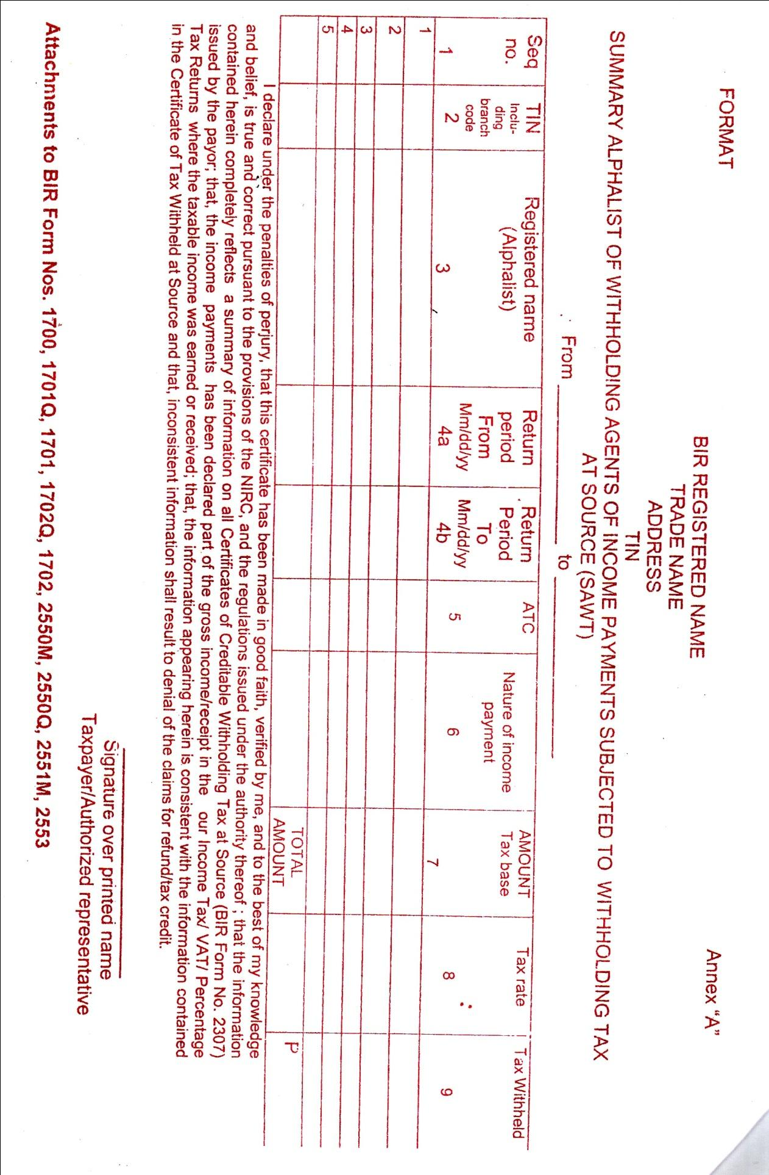
To be submitted by payee – recipient of income

Slide 17
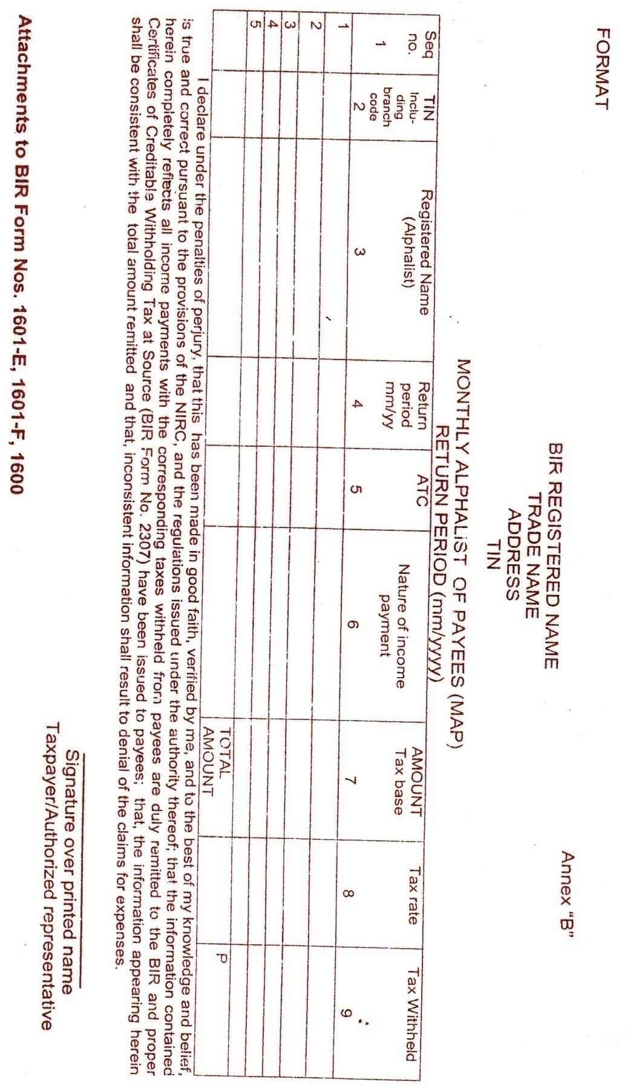
Monthly Alpha List of Payees (MAP)
Whose income received has been subjected to withholding tax to tax returns like 1601-E, 1601-F and 1600.
To be prepared by the payor of income

Slide 18
www.depediligan.weebly.com

