Slide 1
EBEIS NSBI SYSTEM 2016

Slide 2
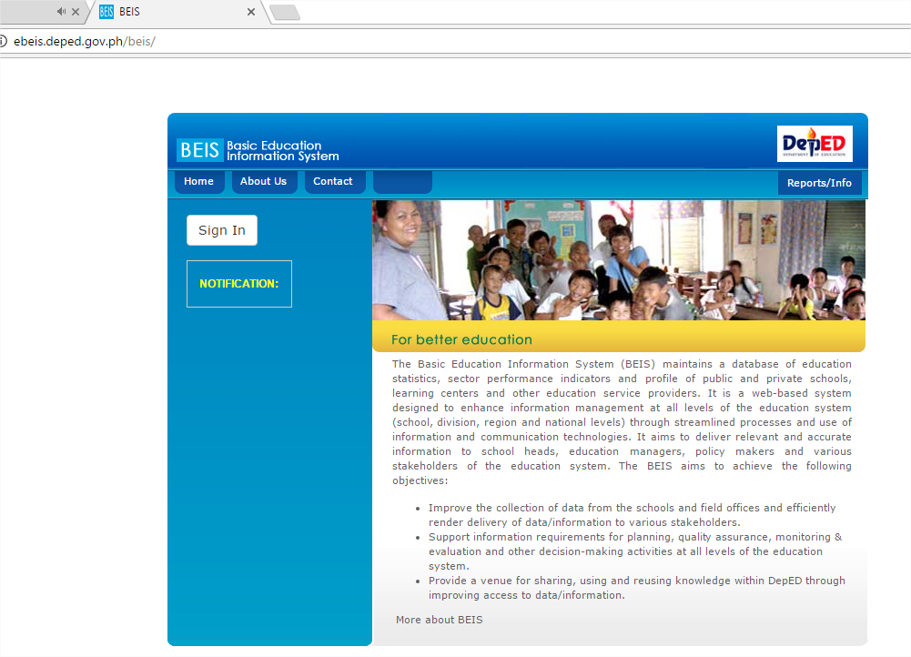
In the address bar of any browser, type the EBEIS Website: http://ebeis.deped.gov.ph/beis
Click Sign In

Slide 3
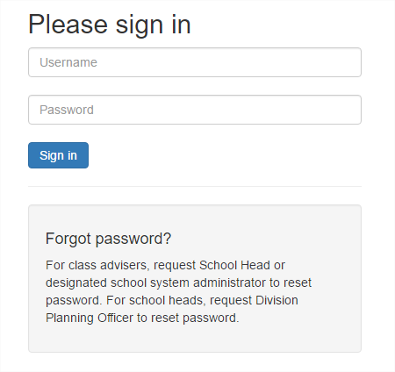
Using the EBEIS Website: http://ebeis.deped.gov.ph/beis, log in using School or System Admin Account

Slide 4
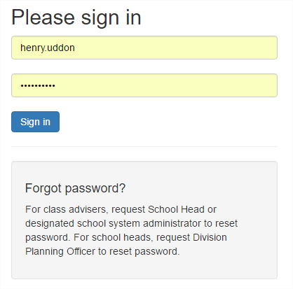
Type the Username and Password then Click Sign in
Click

Slide 5
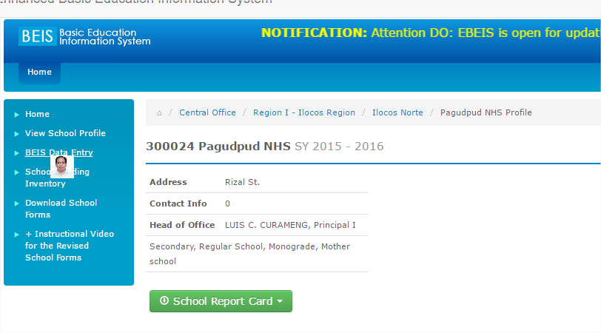
In the EBEIS Menu, Click BEIS Data Entry link

Slide 6
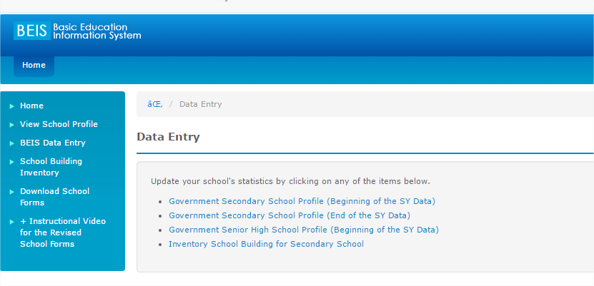
Click Inventory School Building for Elem/Secondary School

Slide 7
In the Cut off Date, Click 2016, Dec 31 link

Slide 8
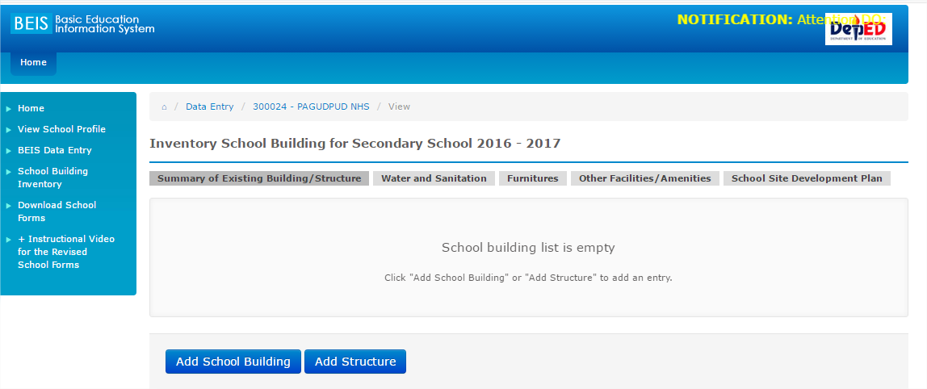
Using the NSBI Form, please refer to Building/Structure Number 1, see if School Building or Structure, if School Building, Click Add School Building, if Structure, Click Add Structure, For Ex. Building/Structure 1 is Canteen, so it is Structure, Click Add Structure

Slide 9
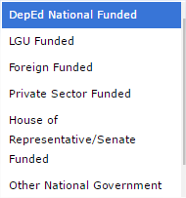
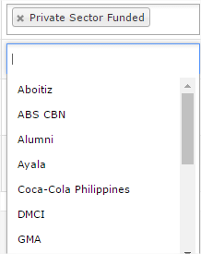
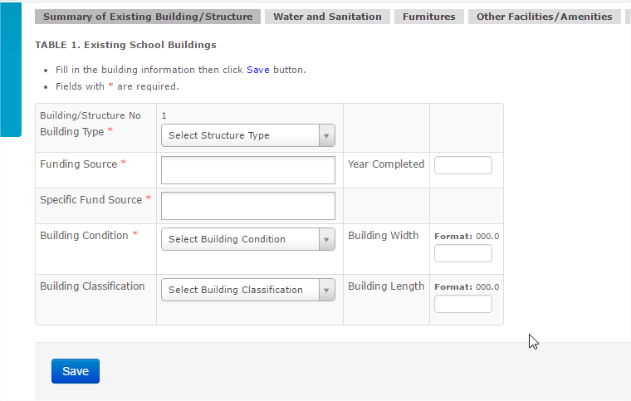
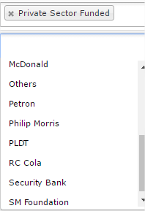
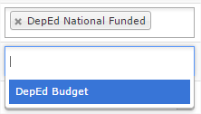
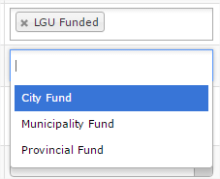
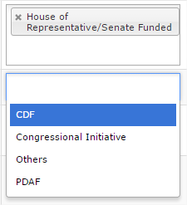
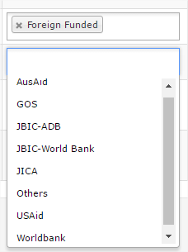
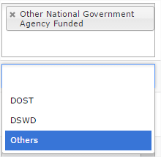
Funding Source and Specific Fund Source
Fill out the Table 1 (Please refer to your NSBI Form)

Slide 10
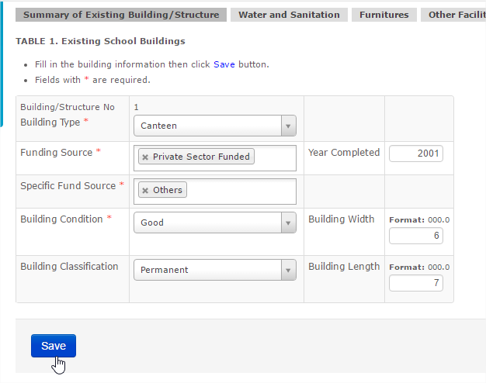
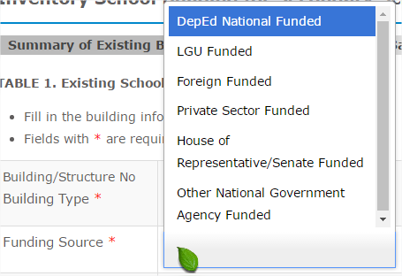
Click Here to select or you can type the first 3 letters then select, if none in the list, select others, then Type the Name of Building/Structure
Type or sselect
To fill out Funding Source, just click the box then it will display the selection, just click to select, to delete, just click x, click again the box if multiple Fund sources, then select. Same procedure for the Specific Fund.
Click Here to Select Building Condition and Classification
Type
Type
After filling out, click Save
Click

Slide 11
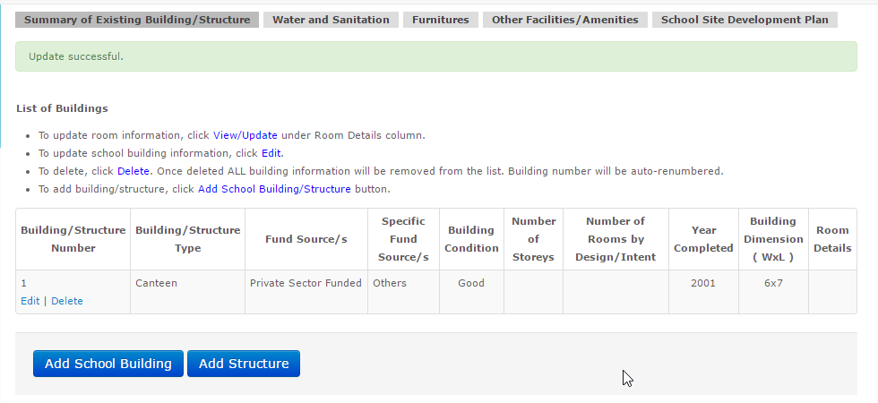
Click Edit to Update School Building/Structure Information or Delete to remove from the list
B/S 1 is already added, refer again to the NSBI Form for the next entry, B/S 2 is School Building, so Click Add School Building

Slide 12
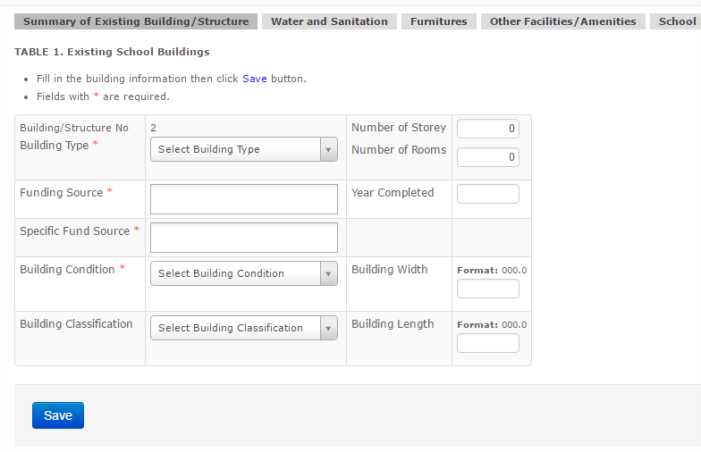
Click Here to select or you can type the first 3 letters then select, if none in the list, select others, then Type the Name of Building/Structure
To fill out Funding Source, just click the box then it will display the selection, just click to select, to delete, just click x, click again the box if multiple Fund sources, then select. Same procedure for the Specific Fund.
Click
Click
Click Here to Select Building Condition and Classification

Slide 13
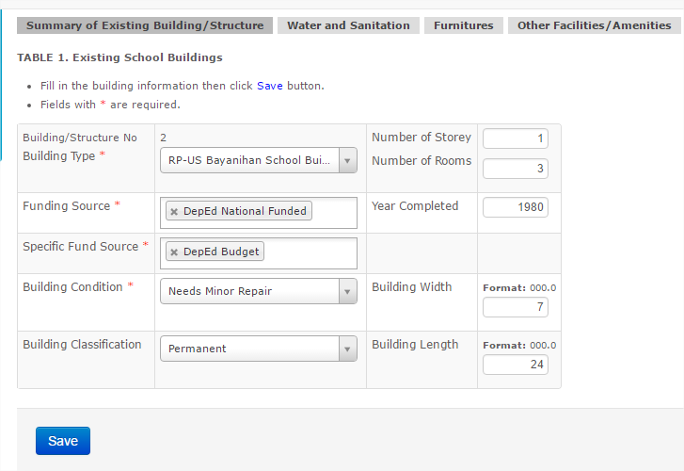
After filling out, click Save
Click

Slide 14
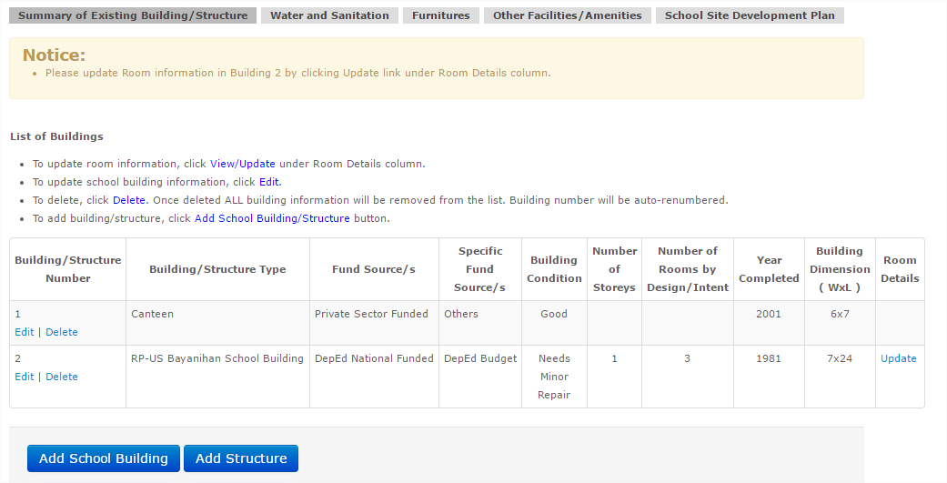
Please Read
Click
In B/S 2, click Update to fill out Room Details column

Slide 15
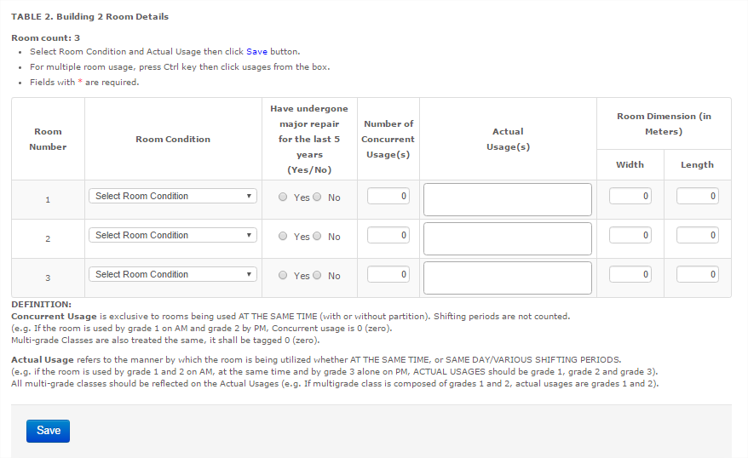
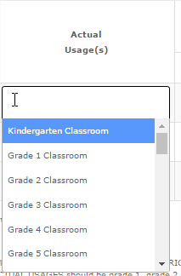
For Actual Usage(s), just click the box, then Type 4 letters to display the selection, then Click to Select or Scroll Down, then Select. If multiple usages, click again the box, then select.
You can only input 0, 2, 3, 4 or 5
Click Here to select Room Condition
Click
Type room Dimensions
For Table 2, please refer to your NSBI Form Table 2, then fill out the Room Details of the Building

Slide 16
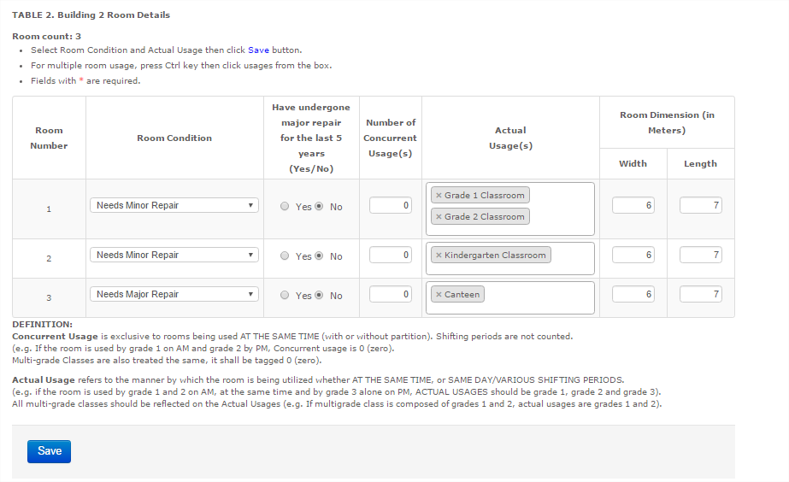
After filling out the Table 2, Click Save

Slide 17
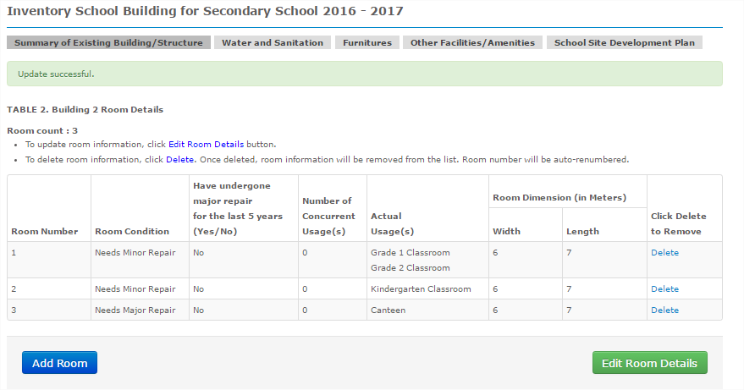
Click to Display Existing Building or Structures
To Delete room information
To Delete Room
Click Here to Add Room
To Update room information
Click

Slide 18
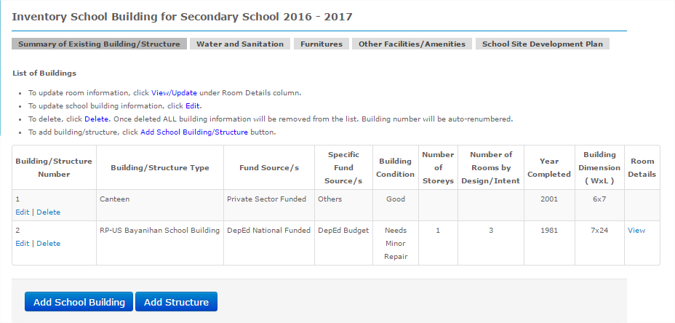
To update room information, Click View Under Room Details Column
B/S 1 and 2 are already added, refer again to the NSBI Form, just follow the previous steps until Building/Structures in Table 1 are all added.

Slide 19
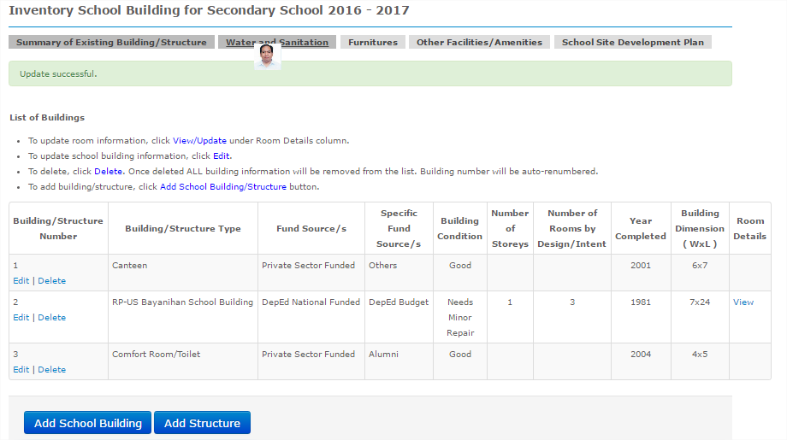
After adding all the Buildings and Structures in Table 1 and Room Details in Table 2, Click Water and Sanitation Tab

Slide 20
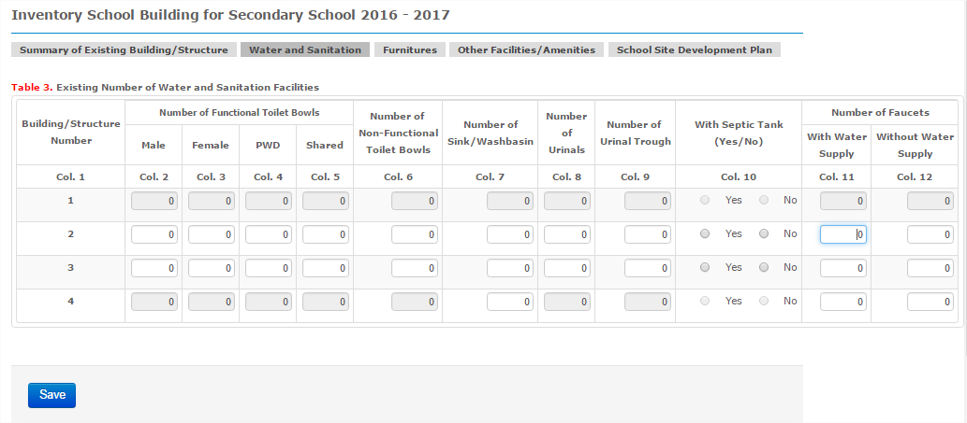
You will notice that input fields on row 1 and row 4 are all disabled. This is because row 2 and 4 represent our Structure. Note that for this table, fields shaded with gray are all disabled except for buildings and two type of structures, comfort rooms and water facilities.

Slide 21
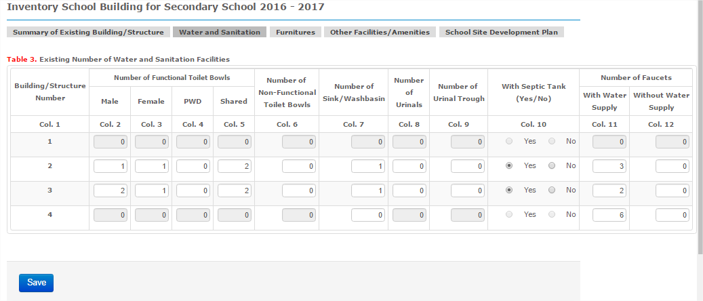
Please refer to NSBI Form Table 3 to accomplish this Table, After encoding the data in table 3, Click Save
Click

Slide 22
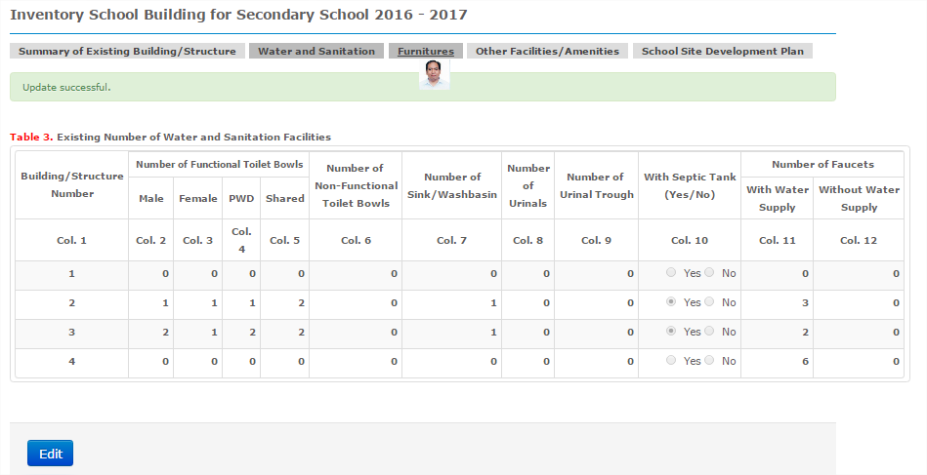
Click Edit to update Table 3. After accomplishing Table 3, Click Furniture to encode Table 4
Click

Slide 23
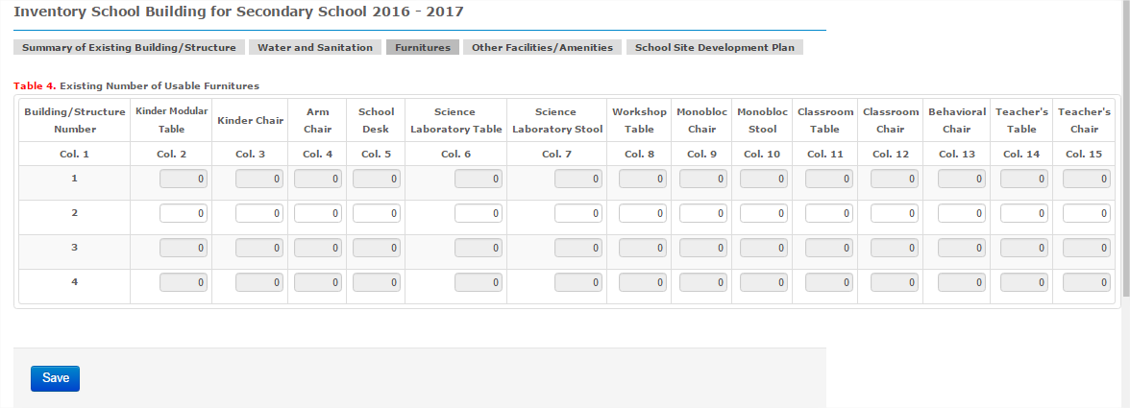

Slide 24
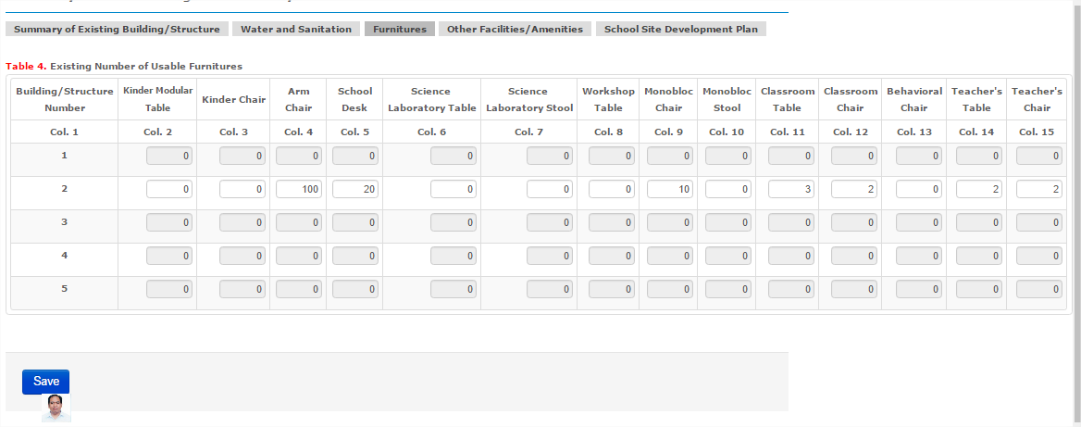
Based from Table 4 in the NSBI Form, encode the data and click Save to save information

Slide 25
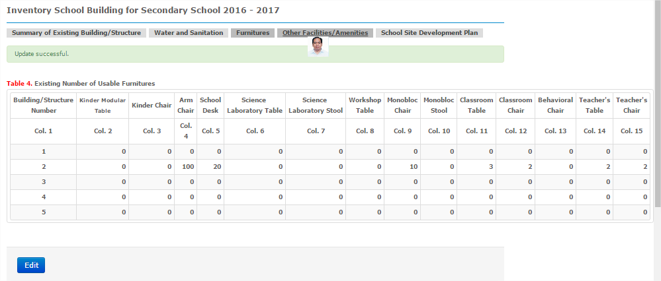
Click Edit to update Table 4. After accomplishing Table 4, Click Other Facilities/Amenities to encode Table 5
Click

Slide 26
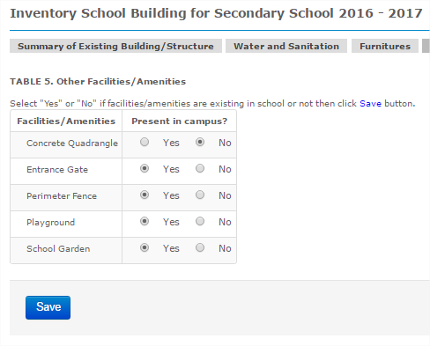
Based from Table 5 in the NSBI Form, fill out the data and click Save
Click

Slide 27
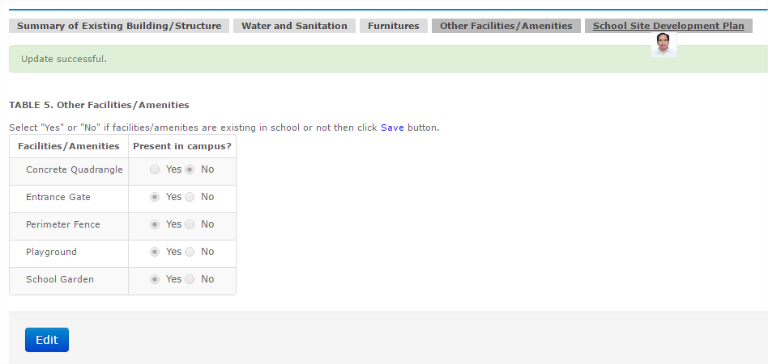
Click Edit to update Table 5. After accomplishing Table 5, Click School Site Development Plan to upload the Scaled Site Development Plan
Click

Slide 28
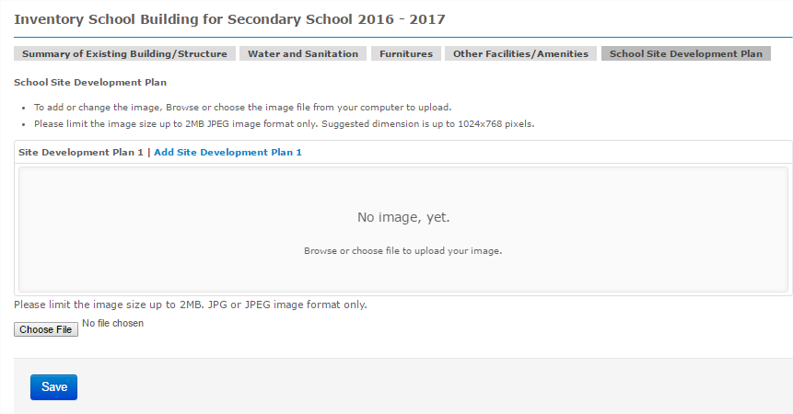
Please Read
Click
Click Choose File, then browse the location of the image of the Scaled Site Development Plan

Slide 29
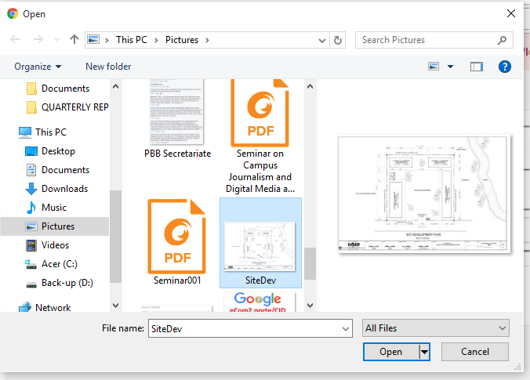
Click
Browse the location of the image (in jpg) and select then Click Open

Slide 30
Click
Click Ok if you have uploaded the correct Site Development Plan

Slide 31
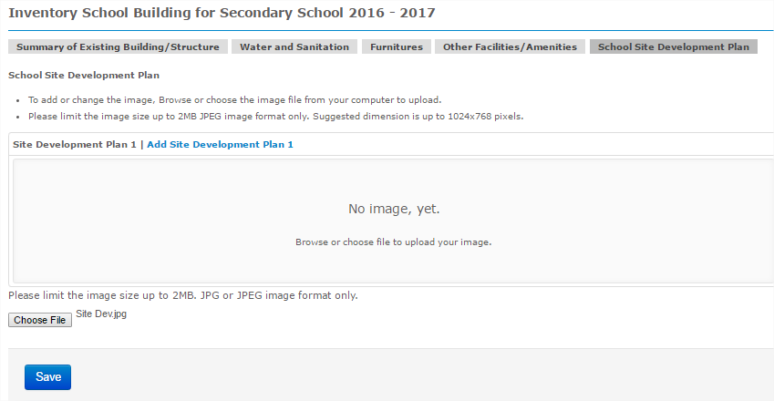
After Choosing the image of the Scaled Site Development Plan, click Save
Edit

Slide 32
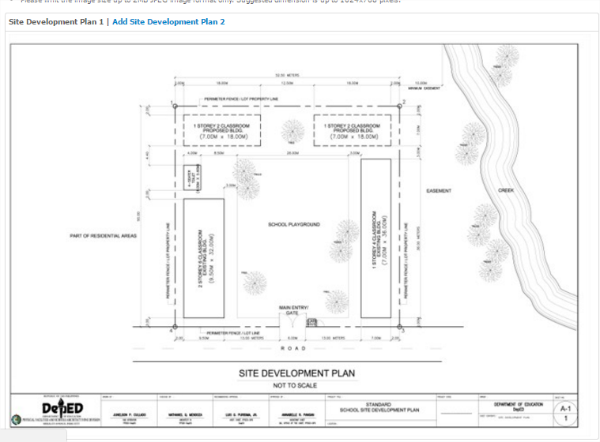

Slide 33
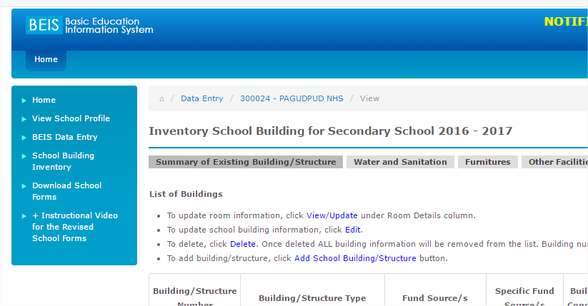
How to Submit NSBI Online
Before submitting online, please make sure that you have encoded all the data in all the tables, and your NSBI Forms were validated by the SGOD Office, Click BEIS Data Entry

Slide 34
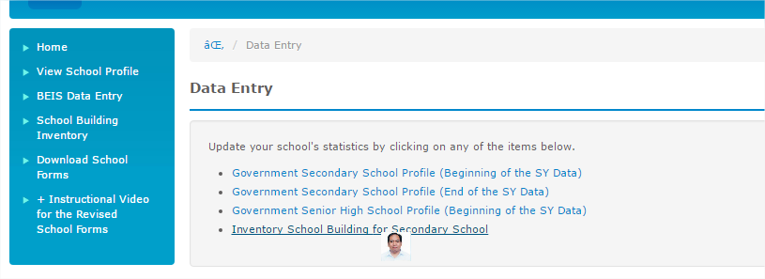
Click Inventory School Building for Elem/Secondary School

Slide 35
In the Action Column, Click Submit link

Slide 36
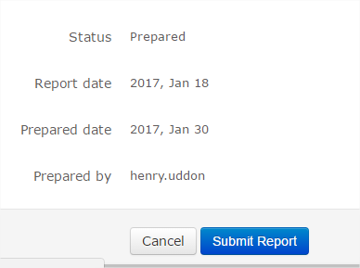
Click Submit Report

Slide 37
End of Presentation
THANK YOU!

