Slide 1
Technical-Vocational-Livelihood Equipment and Tools Specifications
1 February 2016

Slide 2
Objectives
Share with the BACs the following:
K12 Curriculum Framework theWonderful World of TVL Education
List of tools and equipment vs technical specifications
Key concepts in the development of the technical specifications for TVL tools and equipment
Provide an overview of:
Process of preparing the technical specifications for Technical-Vocational-Livelihood (TVL) Equipment and Tools
Database Management System Software developed for the TVL Equipment and Tools

Slide 3
Objectives
Present Masonry TVL specialization as an example
Technical specifications
Costs based on Manila prices
Present national data on TVL offerings by region
Issues to consider before procurement
Program offerings
Utilization Ratios
Internal assessment (inventory of existing tools and equipment
Schedules: time needed in schools, delivery and installation, procurement timeline
Interface relationships between RO, SDO and/or CO

Slide 4
The K to 12 Basic Education Curriculum Framework
Notes:
Let’s start with the framework of the K to 12 Basic Education Curriculum.

Slide 5
The K to 12 Philippine Basic Education Curriculum Framework
Holistically Developed Filipino with 21st Century Skills
Being and Becoming a Whole Person
SKILLS
Information, Media, and Technology Skills
Learning and Innovation Skills
Communication Skills
Life and Career Skills
LEARNING AREAS
Language
Technology and Livelihood Education (TLE)
Mathematics and Science
Arts and Humanities
Curriculum Support System
Teachers
Materials, Facilities, and Equipment
ICT
Environment
Assessment
School Leadership and Management
Schools Divisions Technical Assistance
Community-Industry Relevance and Partnerships
Monitoring and Evaluation System
DEPARTMENT OF EDUCATION
Notes:
Holistically developed Filipino
21st century skills
Learning areas
Strong curriculum support system
Monitoring and evaluation system

Slide 6
Basic Education Program
Elementary
Kinder to Grade 6
Junior
High
School
Grades 7 to 8
(Exploratory TLE)
Grades 9 to 10
(Specialized TLE)
Senior
High
School
Core Subjects
Tracks
Applied Track Subjects
Academic Track
Technical Vocational Livelihood Track
Sports Track
Arts & Design Track
General Academic Strand
STEM
ABM
HUMSS
Home Economics
Agri-Fishery
Industrial Arts
ICT
DEPARTMENT OF EDUCATION
Notes:
Structure/architecture of the K to 12 curriculum
Elementary: K-6
Junior High: 7-10
SHS: 11-12
SHS curriculum has 4 tracks:
Academic
Technical-Vocational-Livelihood
Sports
Arts and Design

Slide 7
Technical-Vocational-Livelihood Track TESDA Training Regulations-Based Specializations
HE | ICT | Agri-Fishery Arts | Industrial Arts
Beauty/Nail Care Wellness Massage Dressmaking Front Office Services Travel Services Cookery Hairdressing Tailoring Caregiving Food and Beverage Services Bread and Pastry Production Housekeeping Tour Guiding Services Tourism Promotion Services Attractions and Theme Parks Tourism Handicraft (Needlecraft) Handicraft (Fashion Accessories and Paper Craft) Handicraft (Woodcraft) Handicraft (Leathercraft) | Computer Hardware Servicing Illustration Technical Drafting Contact Center Services Computer Programming Medical Transcription Animation | AGRICROP PRODUCTION Crop Production Horticulture Landscape Installation and Maintenance Organic Agriculture Production Pest Management Rice Machinery Operation | Masonry Automotive Servicing Refrigeration and Air-Conditioning Consumer Electronics Servicing Electrical Installation and Maintenance Shielded Metal-Arc Welding Carpentry Plumbing (NC I) Plumbing (NC II) Tile Setting
 |  | ANIMAL PRODUCTION Animal Production Artifical Insemmination Raising Large Ruminants (Dairy Cattle and Buffaloes) Raising Swine Slaughtering
 |  | FISH PRODUCTION Aquaculture Food (Fish) Processing Fishport/Wharf Operation
Each subject will have 80 hours per semester.
DEPARTMENT OF EDUCATION
Notes:
Exit to NC II qualifications of TESDA
Aligned with Training Regulations
How TVL can lead to decent jobs in different fields
53 old specializations

Slide 8
Technical-Vocational-Livelihood Track 29 New Specializations with Curriculum Guides TESDA Training Regulations-Based Specializations
HE | ICT | Agri-Fishery Arts | Industrial Arts
Fashion Design (NC III) Hairdressing (NC III) Barbering (NC II) Bartending (NC II) Commercial Cooking (NC III) Event Management Services (NC III) | Broadband Installation (Fixed Wireless Systems) (NC II) Telecom OSP and Subscriber Line Installation (Copper Cable/POTS and DSL) (NC II) Telecom OSP Installation (Fiber Optic Cable) (NC II) | Fishing Gear Repair and Maintenance (NC III) Agricultural Crop Production (NC III) Horticulture (NC III) Animal Health Care Management (NC III) Rubber Production (NC I) Rubber Processing (NC II) Fish Products Packaging (NC II) | Automotive Servicing (NC II) Motorcycle/Small Engine Servicing (NC II) Driving (NC II) Construction Painting (NC II) Carpentry (NC III) Instrumentation and Control Servicing (NC II) Mechatronics Servicing (NC II) Machining (NC II) Gas Metal Arc Welding (GMAW) (NC II) Gas Tungsten Arc Welding (GTAW) (NC II) RAC (PACU/CRE) Servicing (NC II) Electric Power Distribution Line Construction (NC II)
Each subject will have 80 hours per semester.
Each subject will have 80 hours per semester.
DEPARTMENT OF EDUCATION
Notes:
Exit to NC II qualifications of TESDA
Aligned with Training Regulations
How TVL can lead to decent jobs in different fields
53 + 29 = 82 specializations altogether

Slide 9
List of tools and equipment vs technical specifications

Slide 10
Example of a list of tools
Shovel
Steel trowel, pointed
Steel tape measure
5m Mason's hammer
Plumb bob
Scaffolding
Hand saw, cross cut
Steel Bar cutter
Steel framing square
Cold chisel
Hacksaw w/ blade
Straight edge rule
Spirit level Claw hammer
Chalk line
Tri- square
Steel brush
Wheel barrow
4” Paint Brush
2” Paint Brush
Crow bar
Sledge hammer
Rope 1” dia.
Pulley
One bagger mixer
Hard Hat
Safety Goggles
Safety Shoes
Arc Welding machine
Portable Grinder
Hammer drill
Portable Electric drill

Slide 11
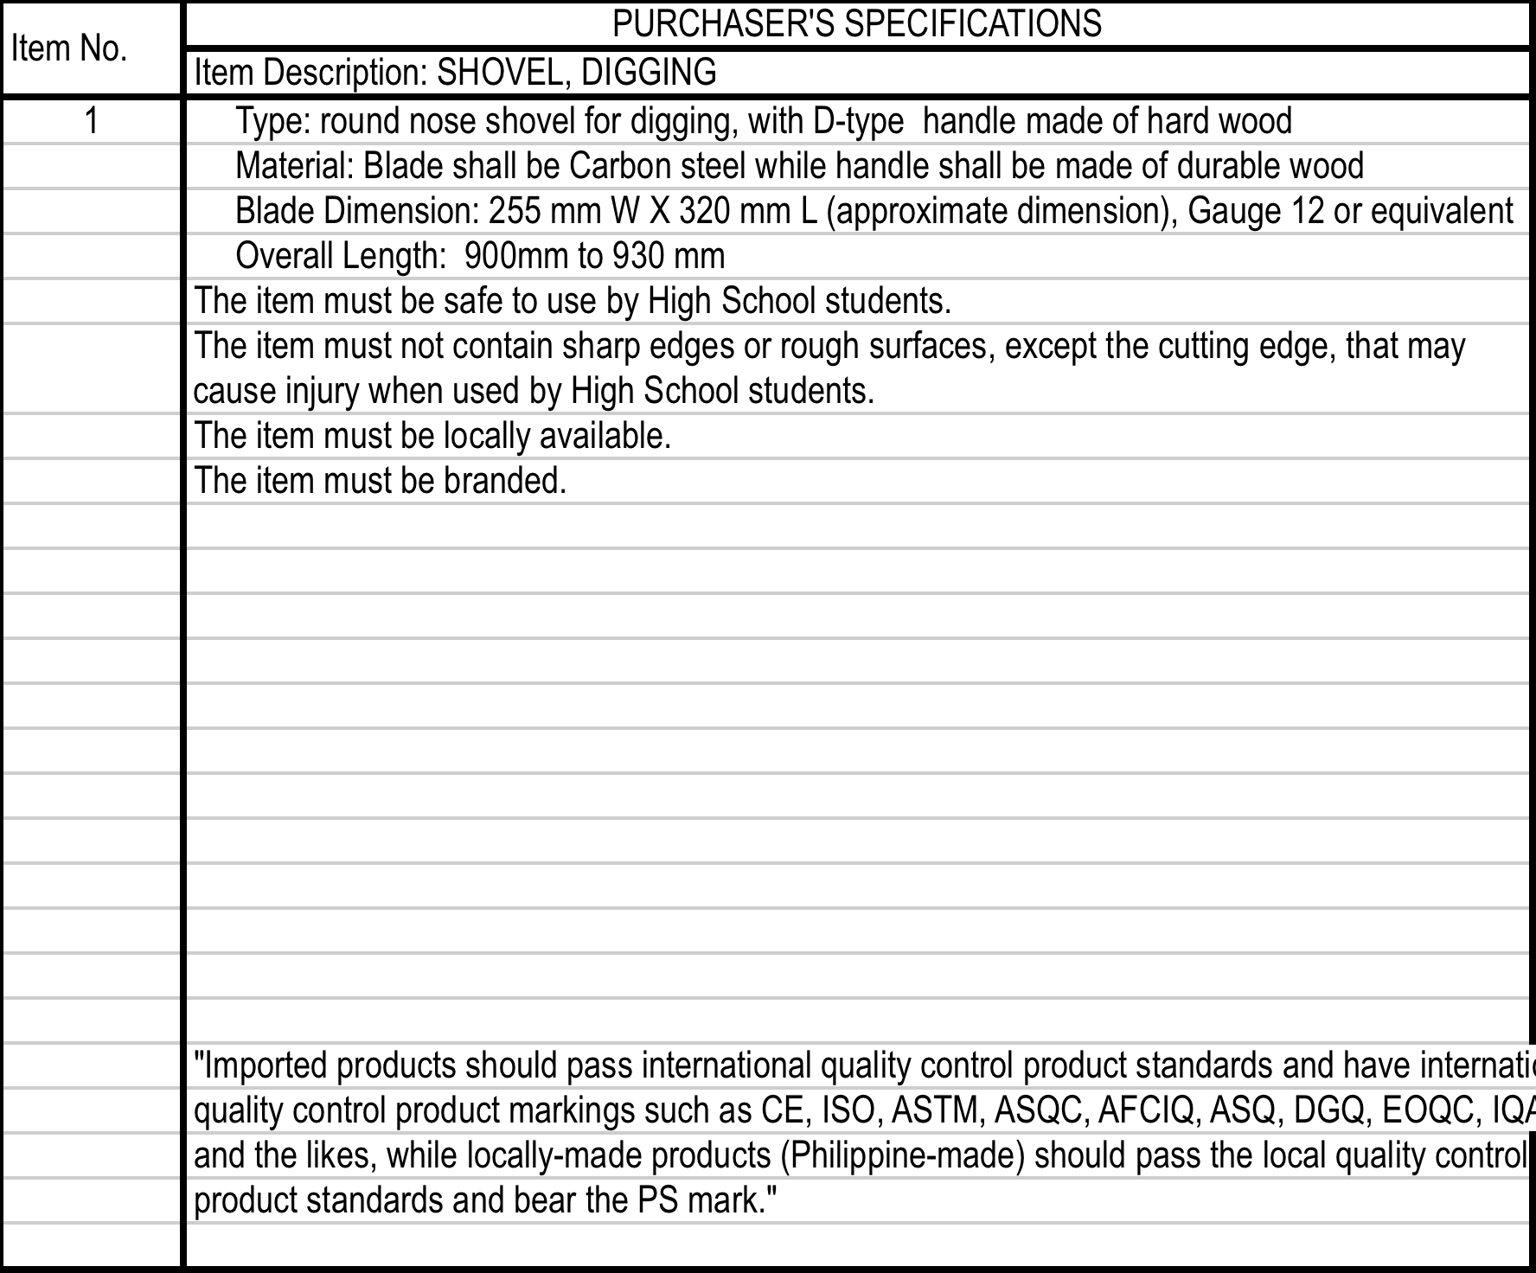
Example of technical specifications

Slide 12
Key Considerations in Drafting the Technical Specifications

Slide 13
What should be considered?
1. Safe for students to use;
2. Durable;
3. Of good quality,
4. Locally available when possible;
5. Locally repairable;
6. Reasonably priced;

Slide 14
What should be considered?
7. Affordable;
8. Student-friendly;
9. Environment-friendly;
10. Reasonable period of usefulness prior to obsolescence;
11. 21st century technology;
12. Developmentally-appropriate.

Slide 15
Preparing the technical specifications for TVL equipment and tools

Slide 16
TVL Equipment and Tools Specifications Writing Process
Transfer of List of TVL Equipment and Tools to TVL Teachers
DepEd TVL Teachers (End User) wrote the following:
Technical Specifications
Internet Costs.
Operational costs.
Waste Management processes.
Pre-validation by NSTIC
TESDA Validation
Second review by NSTIC.
Preliminary Market Survey
Development of the Database Management System Software
Uploading to Database Management System Software.

Slide 17
TVL Equipment and Tools Specifications Writing Process
Start
NSTIC gives the List of Equipment and Tools from TESDA to the TVL Teachers for Specifications writing
TVL Teachers who are NC and/or TM holders receive the list of equipment and tools per TVL Program offering, The TVL Teachers proceeded to write the specifications indicating the following: 1. Technical Specification of Equipment and Tools; 2. Pictures of Equipment and Tools; 3. Three (3) costs from the internet; 4. Power Requirements

Slide 18
TVL Equipment and Tools Specifications Writing Process
TVL Teachers who are NC and/or TM holders receive the list of equipment and tools per TVL Program offering, The TVL Teachers proceeded to write the specifications indicating the following: 1. Technical Specification of Equipment and Tools; 2. Pictures of Equipment and Tools; 3. Three (3) costs from the internet; 4. Power Requirements
Pre-Validation of the Written TVL Equipment and Tools specifications, pictures and costs (3) based from the internet
TVL Teachers present the Written Specifications of Equipment and Tools with pictures and costs (3) to NSTIC for Pre-Validation
NO
NSTIC returns the specifications to the TVL Teachers if there will be revisions needed
Approved?
YES
TVL Teachers revise submitted Equipment and Tools Specifications as returned by the NSTIC after pre-validation
TVL Teachers present the Written Specifications and Costs of Equipment and Tools approved by the NSTIC on Pre-validation to TESDA representatives for Final Validation

Slide 19
TVL Equipment and Tools Specifications Writing Process
TVL Teachers present the Written Specifications and Costs of Equipment and Tools approved by the NSTIC on Pre-validation to TESDA representatives for Final Validation
TESDA Representatives conduct Final Validation on written Technical Specifications of TVL Equipment and Tools using spec writing guideline
Approved?
NO
YES
P&P T.A.s facilitate Marketing Survey Workshop to contractual personnel
P&P T.A.s prepare Marketing Survey Guidelines
P&P T.A.s review approved Technical Specifications of TVL Equipment and Tools validated by TESDA Representatives

Slide 20
TVL Equipment and Tools Specifications Writing Process
P&P T.A.s facilitate Marketing Survey Workshop to contractual personnel
Contractual Personnel / Market Surveyors proceeded to do actual Marketing Survey to known suppliers thru email, fax and shop /store visits
Market Surveyors submit final costs (3) data to P&P T.A.s
P&P T.A.s develop Database Management System for the TVL Equipment and Tools Technical Specifications, pictures and costs (3)
P&P T.A.s forward to Encoders for encoding in the Database Management System all the TVL Equipment and Tools technical specifications, pictures and costs (3)
P&P T.A.s Receive final output from the Market Surveyors
P&P T.A.s prepared proposed Procurement process flow from the regional level
P&P T.A.s submit to Usec of P&P for final approval and turn over to IMCS and procurement office
End

Slide 21
TVL Specification Writing Tools
15Oct2015_Final Validation Guide.xlsx

Slide 22
Database Management System Software for TVL equipment and tools
Example of Full technical specifications for Masonry

Slide 23
Database Management System
Objective
Manage data of all TVL Tools and Equipment technical specification, quantity, cost and pictures.
Automate report generation of technical specifications, costing and pictures.
Prevent alteration of technical specification and cost of all TVL Tools and Equipment.

Slide 24
Database Management System
Advantages
Data is well managed
Reports are easily generated
Data can not be altered ensuring data integrity and compliance to prescribed technical specifications
Saves time and effort within the procurement process

Slide 25
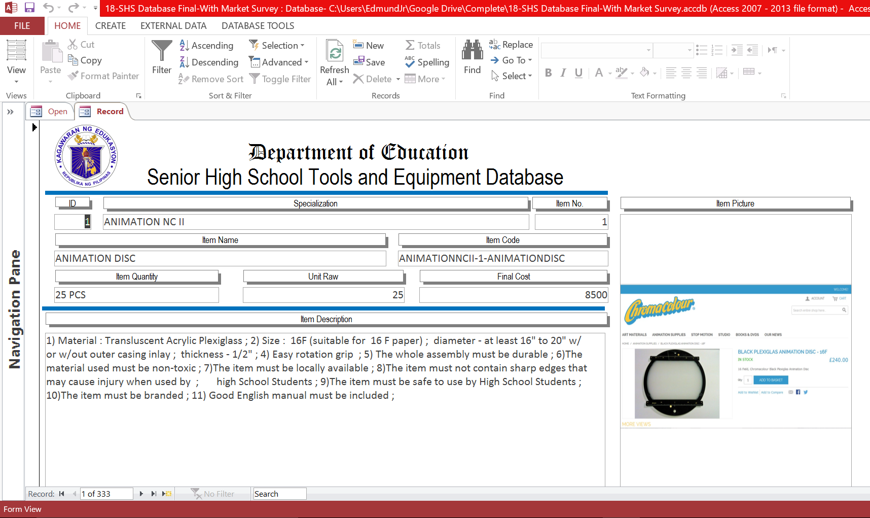
FEATURES: BROWSE RECORDS
:

Slide 26
FEATURES: PRINTING TECH SPECS

Slide 27
FEATURES: PRINTING PICTURES

Slide 28
FEATURES: COSTING QUERY & REPORT

Slide 29
TVL offerings by region

Slide 30
National Data on TVL Specialization
National Data on TVL Specialization Offerings
Per Region and TVL Specialization
Completed TVL Equipment and Tools Specification with Cost for 20 Specializations
Completed TVL Equipment and Tools Specification but incomplete cost for 60 Specializations

Slide 31
Home Economics

Slide 32
Agri-Fisheries

Slide 33
Industrial Arts

Slide 34
ICT

Slide 35
Estimated Cost of tools and equipment for the 20 Completed TVL Specializations per Workshop

Slide 36
Issues to consider when planning procurement

Slide 37
Program offerings
By school
Number of students who will take these programs/specializations
Consequent number of workshops required for the number of students
Consequent number of sets of tools and equipment for the number of students
When the tools and equipment will be needed as per program offering schedule

Slide 38
Utilization Ratio
Tools – 1 tool : 2 learners/class
Equipment such as frying pan – 1 : 5 learners/class
Equipment such as refrigerators - 1/workshop
Materials (consumables) – 1 material : 1 learner/class
Personal Protective Equipment (PPE) – 1 PPE : 1 learner/class

Slide 39
Internal Assessment
Inventory of existing tools and equipment vis-a vis the number of students who will take the TVL specialization
Involve the principal
Will help prioritize which sets of procure
Will also determine the partnership possibilities
Will help in planning for coming years and cohorts
Will contribute to developing the APP for 2017

Slide 40
Schedules to consider
When are the tools and equipment needed by the students
How long will delivery take?
How long will installation take?
What is the procurement timeline?

Slide 41
Interface relationships between RO, SDO and/or CO
Decisions on priorities must be done with the SHS teams of the RO and SDO
TWG for each region must be organized
Technical assistance can be provided to the TWGs for this procurement process
Consider involving the principal or representative in the TWG
Identify the end-user
PS will M&E the procurement process
Reporting processes to BLR must be clarified

Slide 42
Thank you very much!

