Slide 1


Department of Education
DepEd
Computerization Program
(DCP)
Orientation
Handbook
Technical
Service

Slide 2
DCP 2015 Packages
Batch 29 Kinder to Grade 3
1 | Laptop
1 | Projector
1 | Multimedia Speaker
Batch 30 Grade 4 to Grade 6 (1 package)
2 | Host PCs
12 | Thin Clients
1 | Laptop
1 | 48" LED TV (w/ wall mount)
Batch 31 Grade 4 to Grade 6 (2 packages)
4 | Host PCs
24 | Thin Clients
2 | Laptop
2 | 48" LED TV (w/ wall mount)
Batch 32 Grade 4 to Grade 6 (2 packages + tablets)
4 | Host PCs
24 | Thin Clients
2 | Laptop
2 | 48" LED TV (w/ wall mount)
10 | Tablets
Batch 33 Grade 7 to Grade 12
7 | Host PCs
42 | Thin Clients
2 | Laptop
2 | Projector

Slide 3
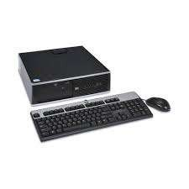
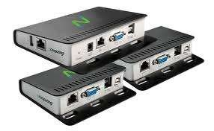
Equipment for Secondary Schools
Summary of Equipment
8 units Host PC
42 units desktop
virtualization/access
terminals/thin client

Slide 4
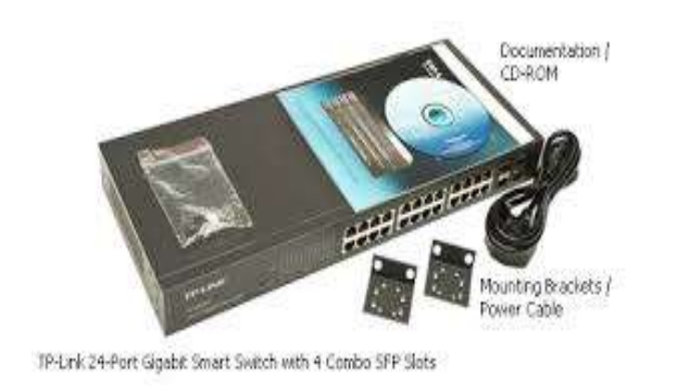
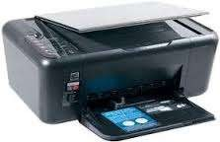
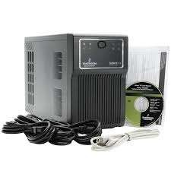

1 unit switch, 24 ports,
10/100/1000Mbps
1 unit Printer with driver
software CD and 1 set of ink
cartridge
1 unit Uninterruptible Power
Supply (UPS)
42 units LED Monitor

Slide 5
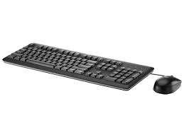

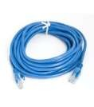



42 units USB Keyboard and
Mouse
4 sets Cat 5e Patch Cords
Software
Windows Multipoint Server
Microsoft Office 2013
DepEd Computerization Program (DCP) Orientation Handbook
Page 7

Slide 6





Anti-virus software
Ncomputing Virtualization Software
Recovery CD
NetSupport School
Equipment for Elementary Schools
Summary of Equipment
1 Unit Host PC
DepEd Computerization Program (DCP) Orientation Handbook
Page 8

Slide 7
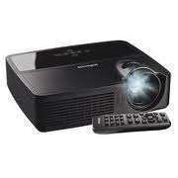
6 units desktop
virtualization/access
terminals/thin client
1 unit 3-in-1 inkjet printer with
driver software CD and 1 set of
ink cartridge
2 units Projector
1 unit Uninterruptible Power
Supply (UPS)
DepEd Computerization Program (DCP) Orientation Handbook
Page 9

Slide 8
7 units LED monitor
7 units - USB Keyboard and
Mouse
1 set Patch Cords
DepEd Computerization Program (DCP) Orientation Handbook
Page 10

Slide 9

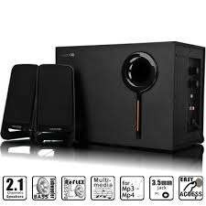
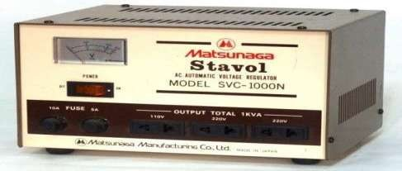
1 unit Laptop with bag
1 unit multimedia speaker
1 unit Automatic Voltage
Regulator (AVR)
DepEd Computerization Program (DCP) Orientation Handbook
Page 11

Slide 10


2 Projector Screens
Software
Operating System: Windows Multipoint Server (for host PC and desktop virtualization)
Laptop: Windows 8
Microsoft Office 2013
DepEd Computerization Program (DCP) Orientation Handbook
Page 12

Slide 11
Anti-virus software
Ncomputing Virtualization Software
Recovery CD
NetSupport School
DepEd Computerization Program (DCP) Orientation Handbook
Page 13

Slide 12
Pre-delivery
The school must prepare the complete counterpart requirements as prescribed by DepEd
Central Office:
1. Room spacious enough to house the computer units
Tables
2. Chairs
3. Aircondition OR at least two (2) Electric Fans
4. Sufficient Lighting
5. Windows and Doors with iron grills
6. Proper Electrical Wirings with circuit breaker and proper electrical grounding
7. Standard electrical outlets with appropriate load capacity
8. Engaging the assistance of Barangay Officials for security mechanism
As proof that the recipient school is ready to receive the DCP package, an accomplished School Readiness Checklist must be submitted to DepEd Technical Service prior to delivery.

Slide 13
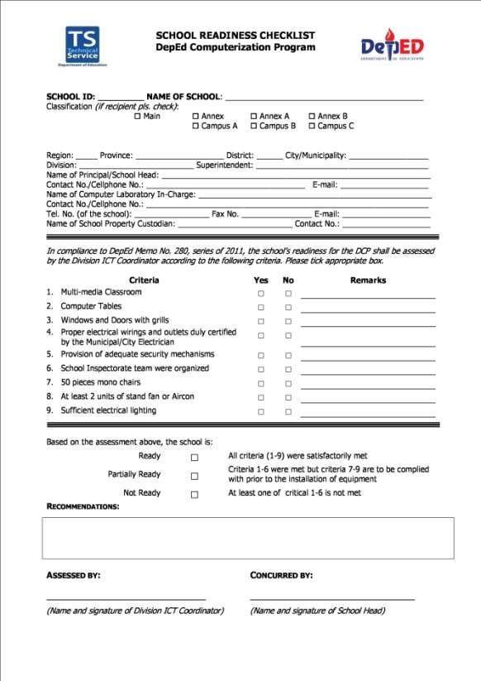
Sample School Readiness Checklist
DepEd Computerization Program (DCP) Orientation Handbook
Page 14

Slide 14
Delivery Procedure
Information
1.
The DepEd Division Office through the ICT is informed of the schedule of deliveries for the
recipient schools.
The recipient schools are informed of the delivery schedule.
The recipient schools receive a call from the Supplier’s delivery partner before the actual
delivery to confirm that delivery will push through.
2.
3.
Actual Delivery
1.
The delivery truck arrives at the school.
1.1. The delivery personnel looks for the one of the following school representatives to receive the items in the following order:
Property Custodian
Authorized representative (with authorization letter)
None of the above means NO DELIVERY.
1.2. If property custodian will receive the items, he/she needs to present Front and Back
photocopy of their School ID / DepEd ID
1.3. If the authorized representative will receive the items, he/she needs to present the following:
1.3.1.
1.3.2.
1.3.3.
Authorization Letter signed by the Property Custodian
Front and Back photocopy of the Property Custodian’s School ID / DepEd ID
Front and Back photocopy of the representative’s School ID / DepEd ID
2.
The delivery personnel unload the items in the secure room provided by the school.
3.
The property custodian or his/her authorized representative inspect the BOXES ONLY for
signs of tampering, mishandling or damages.
DepEd Computerization Program (DCP) Orientation Handbook
Page 15

Slide 15
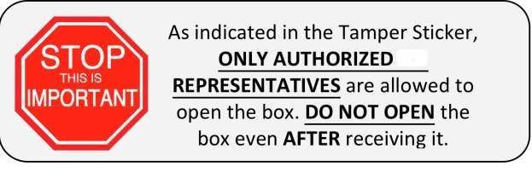
Look for this sticker (Figure 1) and make sure that it is not torn or removed in any way.
Figure 1. Supplier’s Tamper Sticker
PLEASE ENSURE THAT THIS STICKER IS NOT REMOVED / TAMPERED. OTHERWISE, RECIPIENT SCHOOL WILL BE RESPONSIBLE FOR ANY LOSSES/DAMAGES.
ONLY AUTHORIZED <name of supplier> REPRESENTATIVE/S IS/ARE ALLOWED TO OPEN THIS SEAL. ONCE TAMPERED, <name of supplier> WILL NOT BE HELD LIABLE FOR ANY DAMAGE OR LOSS.
4. If the boxes are OK, school representatives sign the Forwarding Bill (Figure 2)
DepEd Computerization Program (DCP) Orientation Handbook
Page 16

Slide 16
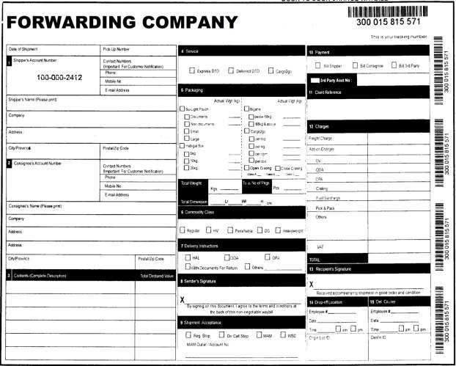
Figure 2. Forwarding Company bill
DepEd Computerization Program (DCP) Orientation Handbook
Page 17

Slide 17




Delivery
Inspection
Acceptance
Delivery
Responsibilities of the supplier/manufacturer/contractor
1. The delivery must be within the specified period at the location/s indicated in the P.O. or contract.
To be done on weekdays
between 8am to 5pm
2. The delivery must be in accordance with technical specifications, terms, and conditions.
3. Deliveries are in accordance with the Consumer Act of the Philippines (R.A. 7394)
“All supplies shall be
adequately”: contained,
packed, crafted, cased,
bundled, wrapped
Failure to deliver within the prescribed period, the supplier/manufacturer/ contractor shall be liable for penalty, usually in the form of Liquidated Damages. 1/10 of
1%
Once the accumulative amount of Liquidated Damages reaches 10% of the
contract, the procuring entity can cancel the contract.
Conditions for the extension of the delivery period:
1. Force Majeure: chance occurence, unforseeable and/or uncontrollable event 2.
Fortuitous Event
3. Events beyond the control of the contractor.
4. Delay caused by the buyer and/or recepient entity.
✓ In case of calamities, deliveries can be accepted by nearby schools, but only for safekeeping.
✓ Supply Officer/Designated Property Custodian forwards Original DR &
Copy 2 of Approved P.O. to the Inspection Committee for inspection of the
deliveries
DepEd Computerization Program (DCP) Orientation Handbook
Page 18

Slide 18
CONSUMER ACT OF THE PHILIPPINES
Crafted
Cased
Packed
Bundled
R.A.
7394
Contained
Wrapped
DELIVERY PROCEDURES
Reject delivery
E
Shall be done on
weekdays between
8am to 5pm
In
case of
calamities,
A
C
deliveries can be accepted
by
nearby school
for
safekeeping.
Delivery
B
D
Right
quantity
quality
and
Stipulated period and
location
DepEd Computerization Program (DCP) Orientation Handbook
Page 19

Slide 19
If the boxes are NOT OK, follow the following steps:
a.
b.
c.
Inform the Supplier by calling/texting any of the numbers to be provided.
Inform your Division ICT Coordinator regarding the concern
Make a note in the Airway Bill of the observed problems.
Reminders
• Make sure your contact details are updated. The delivery personnel will not be
able to call you if your contact details are wrong.
• Be present on the specified date and time of delivery.
• Inspect the boxes before receiving.
• Above all else, do not open the boxes.
• Supplier policy restricts the opening of the boxes for the protection of the Company, the
Courier and the Client in case some items are missing or damaged.
Depending on the circumstances, for as long as the boxes were not opened prior to
the unboxing by the supplier’s authorized representative; a full investigation on the part
of the supplier and the forwarder is conducted first before involving the school.
• When signing documents, please print full names and designations.
Unboxing
1. The Supplier’s Authorized Service Partner (ASP) calls the recipient school to schedule
unboxing, installation and training dates.
2. The ASP arrives onsite on the scheduled date and proceeds to inspect the delivered items:
2.1 ASP inspects the condition of the outside box for tampering, mishandling, damage.
2.2 ASP opens the boxes and inspects the condition of items and completeness of items,
accessories and other peripherals such as product manuals.
3. If OK, ASP proceeds to the installation step.
DepEd Computerization Program (DCP) Orientation Handbook
Page 20

Slide 20

Reminders
• Be present on the specified date and time of unboxing.
• Ensure that all counterpart requirements have been completed.
Installation
Step by step installation
1.
After the ASP unboxes the items and determines that all items are complete, the ASP
proceeds to begin setup, installation and configuration on each assigned classroom.
After installation, the ASP tests the equipment to ensure all are working and compliant with the technical specifications.
2.
3.
The school must already be prepared with the complete counterpart
prescribed by DepEd Central Office (refer to Pre-delivery)
requirements
as
The installation can only proceed depending
on the readiness of the school’s classroom
or laboratory. Incomplete classroom
requirements means NO INSTALLATION
4.
The school must follow the prescribed eClassroom layout.
DepEd Computerization Program (DCP) Orientation Handbook
Page 21

Slide 21
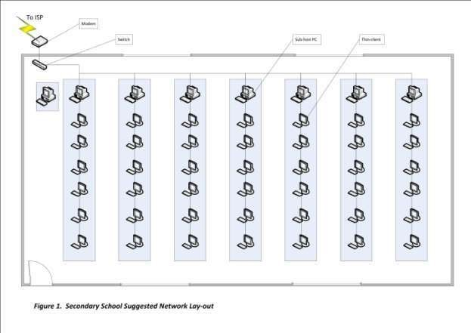
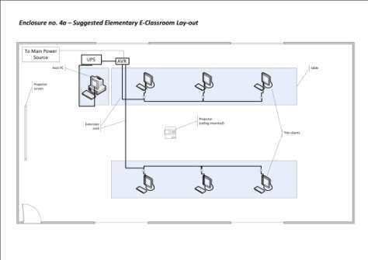
Suggested eClassroom Layout – Secondary
Suggested eClassroom Layout – Elementary
DepEd Computerization Program (DCP) Orientation Handbook
Page 22

Slide 22
Reminders
• Avoid making sudden and unnecessary changes or adjustments to prearranged
installation layouts with the ASP, as this will cause delays.
• Supplier does not permit its ASPs to make any modifications and/or additional
improvements to the equipment and installation specifications set down in the Terms of Reference of DepEd Central Office. Any and all modifications must be consulted first with the supplier.
Liabilities incurred in the performance of any unauthorized work at the behest
of school representatives shall be charged to the school accordingly.
Inspection
Definition
The examination of supplies and services to determine whether the supplies and services
conform to contract requirements. Requirements include: applicable drawings, technical
specifications and purchase descriptions.
Inspection
Techniques
By Item
By Sampling
Random
Interval
DepEd Computerization Program (DCP) Orientation Handbook
Page 23

Slide 23
Methods of Property Inspection
Inspection by Sampling
Usually, 10 % of the entire group is used for sampling
Inspection by Item Individual items are checked for conformity to required specificaqtion
Random Sampling Samples from the delivered group are chosen at random for testing
Interval Sampling
After a certain number of items are counted, a sample is
chosen for testing.
For example, when going through a delivered set of laptops arranged in a line, every 10th laptop is chosen for testing.
For delivered electronic equipment, random and interval sampling methods are not applicable. Inspection by Item must be conducted. Among the details to be checked are:
1. Serial Number
2. Brand Name
3. Model
4. Point of Origin
5. Patent Number
Inspection Committee
1.
The School Principal shall constitute an Inspection Committee consisting of two (2) school personnel and
one (1) representative coming from PTCA/NGO.
Principal/School Head
Appoints inspection committee members
Team Leader
At least a 2nd ranking permanent official of the school
Technical Expert
one (1) school personnel with technical knowledge relevant to the goods delivered
Provisional Member
one (1) representative from
PTA or NGOs
2.
The Inspection Committee must have a copy of the Inspection and Acceptance Report (IAR) and the Serial
Number Checklist.
Inspectors should be familiar with the equipment technical specifications and quantity prior to conducting the inspection.
3.
DepEd Computerization Program (DCP) Orientation Handbook
Page 24

Slide 24
Things to remember during inspection
Physical
Condition
Brochure
Physical
Count
• Are there any scratches, dents, or any other kinds of damages?
• Do the items look new or used?
• User manuals
• Technical support contact details
• How many items were received?
• Are they complete in accordance to the order?
Elements of a computer system
Hardware: physical components of the system such as the monitor, keyboard,
motherboard, circuits, wires, etc.
Software: all non-physical components of the system, such as programs, used to direct computer operations
Inspection Procedures on Computer Packages
1.
Upon receipt of the Request for Inspection, see to it that all required documents are
attached like the original copies of the perfected Purchase Order/Contract, Delivery
Receipt/Sales Invoice, and others.
Check the documents submitted for completeness and authenticity prior to inspection
Take note of any alterations, erasures or other modifications in the perfected Purchase Order/Contract. These modifications must be verified and authenticated by authorized approving officials.
Take note of the receipt of the Property/Supply Unit, the place and date of delivery.
If there’s a required sample mentioned in the perfected Purchase Order/Contract, ask for the approved sample for purposes of comparison/verification. In cases of inconsistencies between sample and the Purchase Order/Contract, specification on the perfected Purchase Order/contract shall prevail.
After all the documents have been evaluated, proceed to the delivery site specified in the perfected Purchase Order/Contract and conduct inspection and testing procedures.
Conduct physical inspection of the items delivered. Count the items delivered and check with the required quantity
Check the packaging, labeling, markings and other means of identification that meet
2.
3.
4.
5.
6.
7.
8.
DepEd Computerization Program (DCP) Orientation Handbook
Page 25

Slide 25
specifications; or if not specifically called for, conform to the best commercial
practices for protecting the items during transportation, storage, handling and distribution.
9. Determine whether it is brand new, reconditioned or rebuilt.
10. Take note of the serial number, product number, point of origin, specifications in accordance with the brochure and accessories that go with the equipment.
11. Take note of:
▪ Obvious damage or defects in the equipment, accessories, connectors, plugs, sockets etc.
▪ any discoloration, rust, stains and decays due to exposure to heat, chemicals or moisture
▪ Ensure that flexible cords are effectively anchored to equipment, plugs and sockets.
12. Perform trial and operational test on the equipment delivered.
▪ Request the supplier to demonstrate the operation of the equipment in the presence of End-User and observe its actual performance.
13. Hearing is essential in the detection of defects indicated by unusual sounds or noises audible when observing the operation of equipment such as knocking, squeaking, sputtering, cracking, breaking, scratching, etc.
14. Consider the characteristics which may be determined by touch or feel, in the inspection of different equipment, include such common, qualities as heat, cold, flexibility, hardness, softness, thickness, firmness, etc.
15. Check the inclusion of warranty certificate and instructional manual.
16. Prepare the Inspection and Acceptance Report immediately after inspection for submission to the Supply Officer for acceptance.
Important Note: Inspection and test for compliance to its features shall at all times
be done in accordance with the following procedure:
Compare the brand, model, power rating of the delivered units with the specifications in the contract
If the contract indicates the brand and model, then, request
for a copy of the brochure or technical manual that will
serve as the basis for inspection
Intangible features (i.e. software and programs) of a
computer may be verified by operating the computer or
by looking into its inside component
DepEd Computerization Program (DCP) Orientation Handbook
Page 26

Slide 26
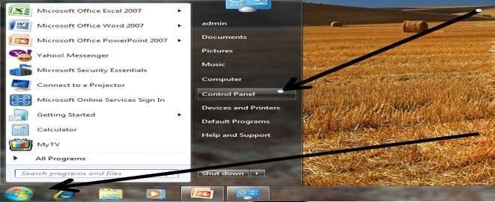
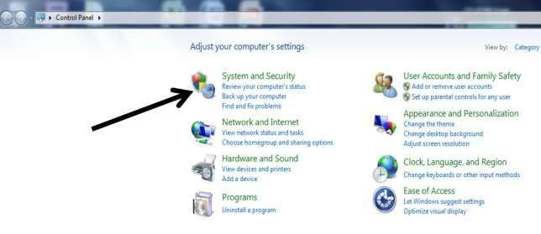
The Inspectorate Team and the Supply Officer / Designated Property Custodian shall prepare
and sign the Inspection and Acceptance Report (IAR).
1.
2.
3.
Original: supplier, to be attached to the DV
Copy 2: Property Inspector/Inspection Team
Copy 3: Property and Supply Unit File
How to check a computer’s specifications
Click on the Start button on the task bar. When the menu opens, select the
Control Panel
DepEd Computerization Program (DCP) Orientation Handbook
Page 27

Slide 27
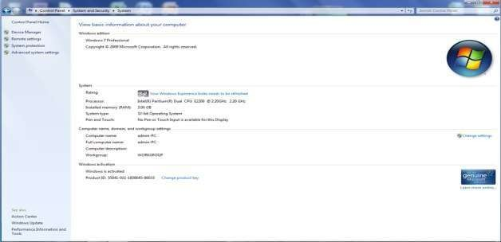
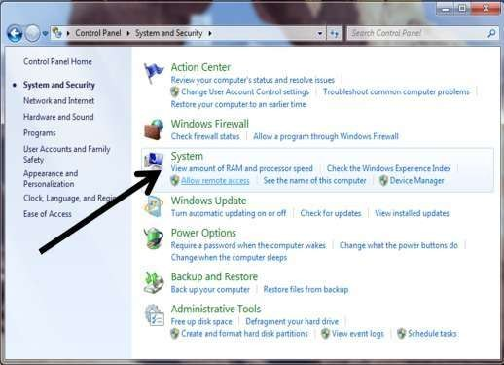
When the Control Panel opens, select System and Security options
Inside the System and Security menu, select System
Once you enter System, it will show the different specifications of the computer
DepEd Computerization Program (DCP) Orientation Handbook
Page 28

Slide 28
Training
1.
School should have 3-10 of its personnel/representatives participate in the Training Course
provided by the Supplier’s service partner.
2.
The Training Course on various topics centered on the operation and maintenance of the
computer equipment.
3.
The school personnel/representatives sign the attendance sheet that forms part of the
Training Checklist. As proof of attendance, attendees are advised to prepare beforehand a copy of their front and back photocopy of School ID/DepEd ID.
3. After the completion of the training, the school Principal/authorized representative signs the
training checklist.
Acceptance
When the delivery, installation, inspection and training have been conducted and accepted,
1.
The School Inspection Committee shall sign the Inspection and Acceptance Report
(IAR) prior to the acceptance by the Property Custodian.
Supply Officer/Designated Property Custodian returns original copy 1 of IAR to the supplier for payment purposes.
2.1. For Secondary/Tech Voc Schools:
2.1.1. With Book of Accounts: The School Head accepts the transfer upon
acceptance of deliveries by the Inspection Committee and the Supply Officer or
designated Property Custodian
2.1.2. Without Book of Accounts: The Schools Division Superintendent accepts
the transfer thru the Invoice Receipt of Property (IRP) upon acceptance of
deliveries by the School Inspection Committee and final acceptance of the Division
Supply Officer
The School Property Custodian provides copy of the IAR to the Division Office – Supply
Office for Booking-Up
The Division ICT Coordinator shall facilitate the signing of Inspection and Acceptance
Report and Invoice Receipt of Property (IRP) for signature of the Division Supply
Officer and Schools Division Superintendent.
2.
3.
4.
DepEd Computerization Program (DCP) Orientation Handbook
Page 29

Slide 29
Warranty Service
The Supplier guarantees three (3) years warranty on parts and service for all non-consumable
items under the DCP Project. The following sections provide information on the extent of warranty coverage, how to avail of warranty service, what to expect and how to properly care for the equipment to avoid breakdown and cases of void warranty.
Service Reporting Procedures
In case equipment problems or breakdown is experienced, the following procedures must be
followed to ensure fast and efficient service:
1.
Before contacting the Supplier:
To report a concern, the school representative must make sure to be ready with the following information:
Name of School:
School ID:
Name & Designation of the person who reported the problem:
Contact Nos:
Type of Machine/Brand/ Model:
Serial #:
Problems Encountered:
2.
The school representative contacts the Supplier’s Care via landline/mobile/email through
the details posted in the Contact Sticker found in every equipment.
3.
If the information is complete, an “Authorized Technician” will call to isolate the concern
and perform Telephone Support within one hour from confirmed receipt of details.
4.
If the information is incomplete, Customer Care will have to call first to complete all
information before a Technician can call to assist.
5.
During Telephone Support:
5.1 If the problem is resolved, Customer Care calls the school to validate completeness
of work and closes the call ticket.
5.2 If the problem is unresolved, the Supplier will perform one of the following:
On-site repair service.
Pullout defective unit for repair.
Send replacement item and perform Telephone Support for installation.
6.
After step 5.2 is performed and the problem is resolved, the Supplier’s Customer Care calls
the school to validate the completeness of work and closes the call ticket.
DepEd Computerization Program (DCP) Orientation Handbook
Page 30

Slide 30
Service Response Time
We recognize the importance of keeping equipment up and running at optimum capacity 100%
of the time and that is why the Supplier shall provide quality customer service at the fastest possible time. For this project, recipient schools will be serviced under the following response times:
Response Type
Response Time
Contact from Customer Care
within 1 hour from receipt of report
Service Support
within 72 hours from completed report to
Customer Care
Onsite service (within city)
within 24 hours from notification of Supplier
Onsite service (provincial/remote)
within 48 hours from notification of
Supplier
Service Reporting Reminders
•
All warranty repairs/services are to
be conducted by the Supplier only. Do not try to
open/repair/modify the item on your own. Any unauthorized tampering or opening
of units shall automatically void the warranty.
•
All reports/concerns are to be forwarded to Supplier only. Service partners who
conducted the Installation and Training are not authorized to conduct repair without notice from the Supplier.
Any charges and/or damages incurred from outsourcing repair to any party other than
the Supplier or its duly assigned partner shall be at the expense of the school and shall void the equipment warranty.
•
Authority to conduct services/repairs/pullout is on a one-time transaction basis only.
Supplier’s
personnel should notify you of the authorized partner for each onsite
visit/repair/pullout.
•
No pullout should be allowed without a service unit.
•
No repair/pullout will be conducted without official notification from the Supplier. Do
DepEd Computerization Program (DCP) Orientation Handbook
Page 31

Slide 31
not entertain couriers or technicians if you have not received any notice from
the Supplier.
• When in doubt, call the Supplier’s Customer Service.
Cases of Void Warranty
Below can be found some common causes encountered by schools why the warranty of their
equipment is voided. Most of the time, these cases may be avoided or prevented by simply following the procedure stated in this manual and keeping in mind the various reminders stated above.
1. Water damage
2. Electrical damage caused by an external power source
3. Unauthorized opening of the item
4. Unauthorized repair using a third-party service center
5. Damage caused by installation of unapproved accessories or software
6. Damage caused by unauthorized modification of parts
Equipment Maintenance and Care Tips
• Keep equipment clean and away from dust.
• Do not eat or allow food near the computer units.
• Keep the computer units plugged in the UPS when operating. The UPS protects your
units from sudden power fluctuations/outages.
• Keep the UPS charged.
• Keep the equipment in its original configuration. Avoid installing unauthorized and/or
unlicensed/pirated software.
• Always keep your anti-virus software up to date.
The school must be ready with its completed documents and facilities, such as rooms
and electricity, before a delivery is made.
DepEd Computerization Program (DCP) Orientation Handbook
Page 32

Slide 32
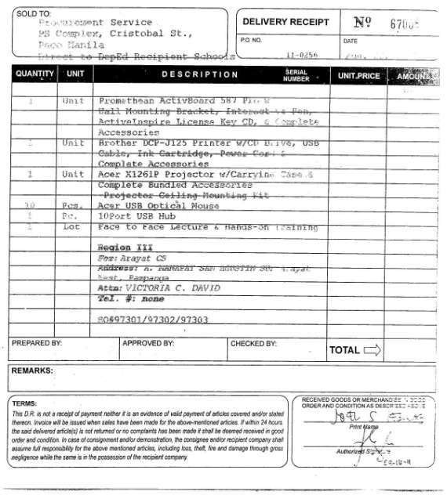
Documents required for deliveries:
Sample Supplier Delivery Receipt and Serial Number Forms
DepEd Computerization Program (DCP) Orientation Handbook
Page 33

Slide 33
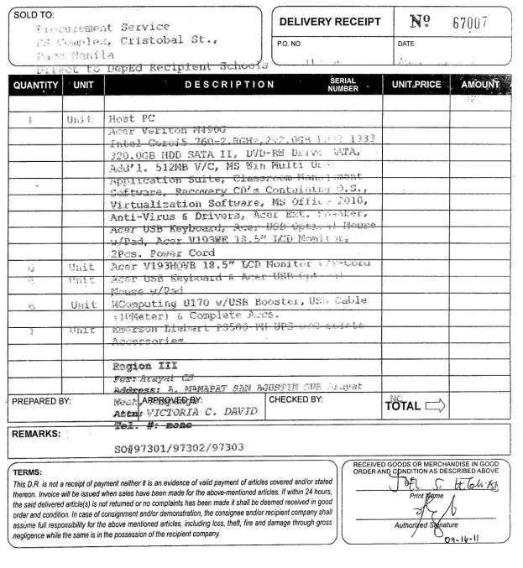
DepEd Computerization Program (DCP) Orientation Handbook
Page 34

Slide 34
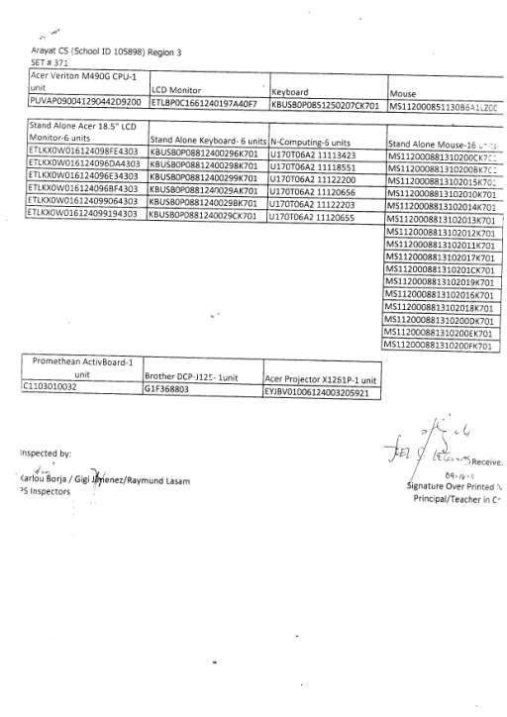
DepEd Computerization Program (DCP) Orientation Handbook
Page 35

Slide 35
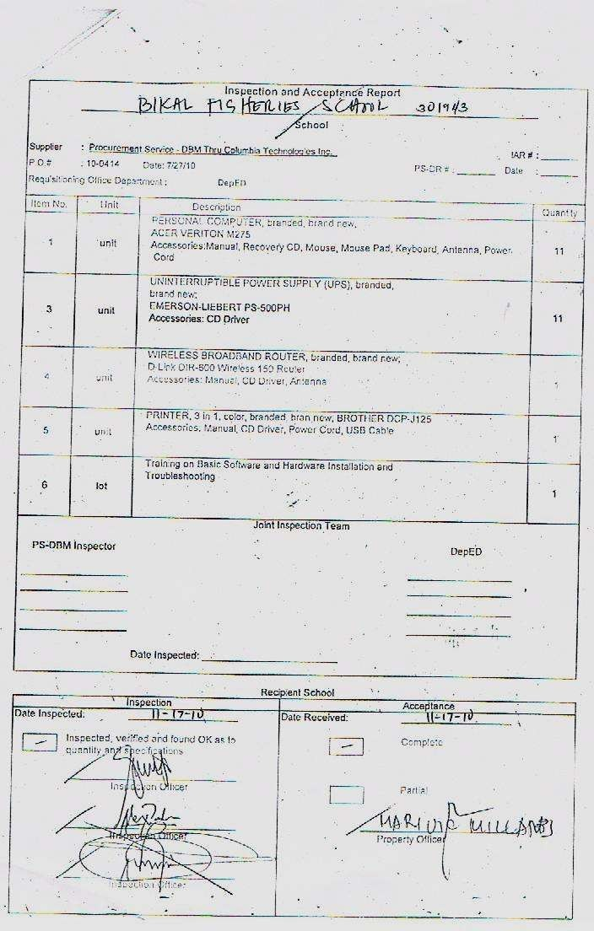
Sample Inspection Acceptance Report
DepEd Computerization Program (DCP) Orientation Handbook
Page 36

Slide 36
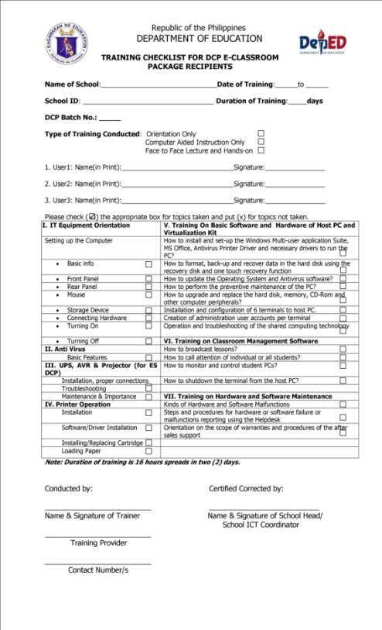
Sample Training Checklist
DepEd Computerization Program (DCP) Orientation Handbook
Page 37

Slide 37
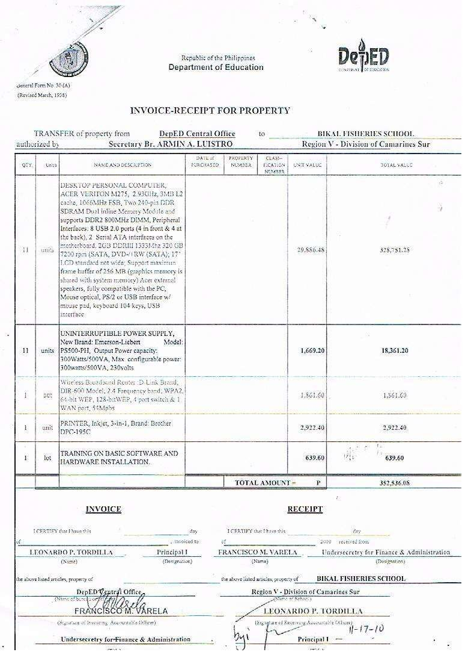
Sample Invoice Receipt for Property
DepEd Computerization Program (DCP) Orientation Handbook
Page 38

Slide 38
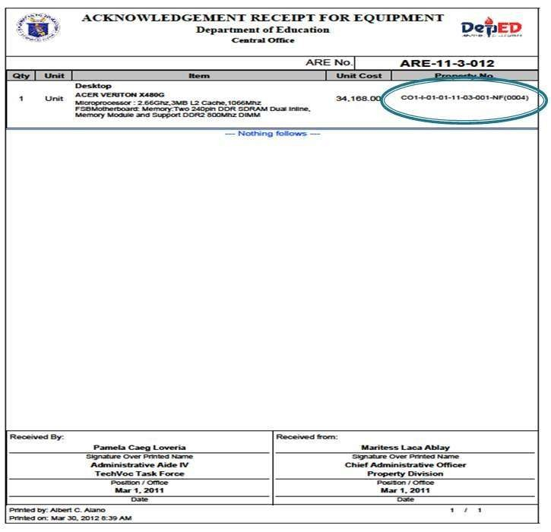
Issuance and Acknowledgement of Items
• Definition: the act of transferring the custodianship of property from one person to
another
• Acknowledgement Receipt of Equipment (ARE): for IT equipment, library books, etc.
DepEd Computerization Program (DCP) Orientation Handbook
Page 39

Slide 39
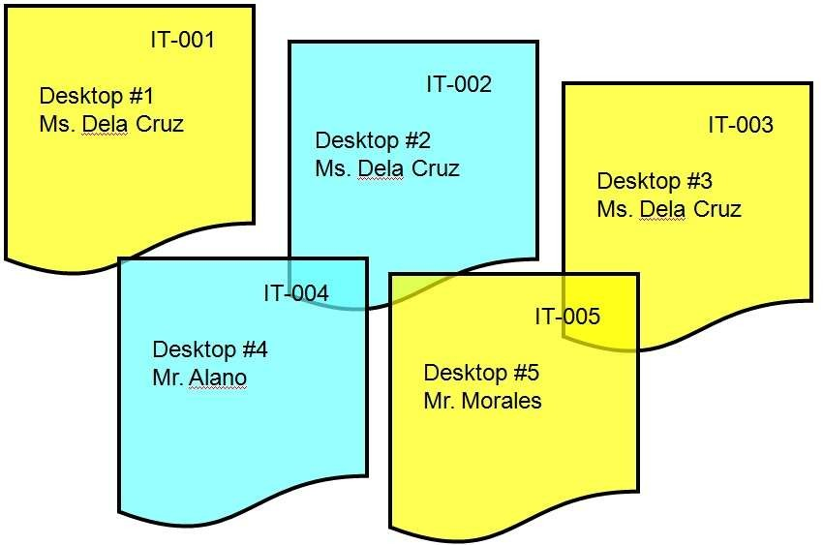
o Preparation of the ARE shall be done per item
Procedures on Acceptance, Inspections, and Recording of Deliveries
Questions (FAQ)
Frequently Asked
1.
What does a school need to do before accepting equipment?
✓ Ensure that there are facilities ready to accommodate deliveries. If these are ICT
equipment, the school must have electricity. School readiness forms must be
submitted to the ICTU at the DepEd Central Office before being eligible to
receive DCP packages.
2.
Who can accept the deliveries?
✓ The Supply Officer/Property Custodian or his/her authorized representative of the school will accept based on technical specifications.
3.
When and where can the deliveries be accepted?
✓ Acceptance of deliveries shall only be done on weekday, 8am-5pm.
✓ Deliveries will be accepted at the location indicated in the Purchase Order (P.O.)
DepEd Computerization Program (DCP) Orientation Handbook
Page 40

Slide 40
or contract.
✓ Deliveries should be rejected if found to be not in accordance with these conditions.
✓ In case of calamities, deliveries can be accepted by nearby schools, but only for safekeeping.
4.
What should be done if the supplier fails to deliver the items within the agreed time
period?
✓ Penalties shall be imposed on the supplier. This would usually come in the form
of Liquidated Damages. Once cumulative amount of liquidated damages reaches
10% of the contract, the procuring entity can cancel the contract.
5.
After acceptance, what must be done with the deliveries?
✓ Inspection. The physical conditions of the items must be checked for damages,
or if they are brand new or used. The items must also be in accordance to what
is indicated in the P.O., following the exact quantity.
✓ Inspection can be done by item or by sampling
6.
Who are authorized to inspect the deliveries?
✓
The head of the office/school will appoint members of an Inspection Committee.
This committee will be comprised of a team leader, a technical expert with
technical knowledge relevant to the goods delivered, and a provisional member
which my come from the Parent-Teacher Association (PTA) or from a
nongovernmental organization (NGO).
The Inspectorate Team and the Supply Officer / Designated Property Custodian shall prepare and sign the Inspection and Acceptance Report (IAR).
The Division ICT Coordinator shall facilitate the signing of Certificate of Final Acceptance and Invoice Receipt of Property (IRP) for signature of the Division Supply Officer and Schools Division Superintendent
✓
✓
7.
What forms must be accomplished, and who shall accomplish them?
Form Prepared by Signed by
Delivery Receipt (DR)
Supplier and DBM (if DBM is
procuring entity)
Supply Officer/Property
Custodian
Inspection and Acceptance
Report (IAR)
Inspectorate team and
Supply Officer/Property
Custodian
Inspectorate team and
Supply Officer/Property
Custodian
Training Checklist
Central Office
School Head
Invoice Receipt of Property (IRP)
Central Office
School Head
Acknowledgement Receipt of
Equipment (ARE)
Supply Officer/Property
Custodian
ICT Coordinator
DepEd Computerization Program (DCP) Orientation Handbook
Page 41

Slide 41
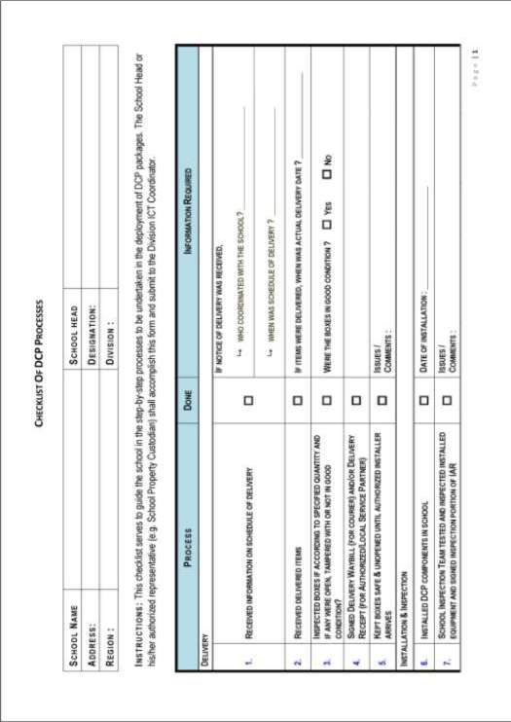
Checklist of School DCP Processes
DepEd Computerization Program (DCP) Orientation Handbook
Page 42

Slide 42
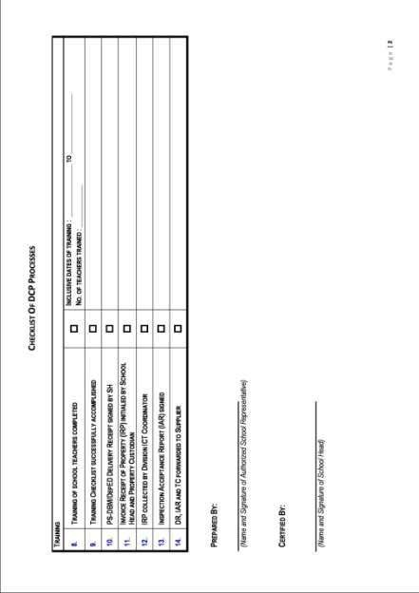
DepEd Computerization Program (DCP) Orientation Handbook
Page 43

